Slide 1
NECSD Capital Bond
Vote May 21, 2019

Slide 2
What is a bond and how do I vote?
A bond is a long-term loan that allows school districts to fund capital projects. Bond approval is done by a referendum (public vote) that includes the scope of the project, maximum dollar amount that can be spent and all funding sources including the maximum amount that can be borrowed.
VOTING INFORMATION
Propositions 4 & 5 on the May 21, 2019 Board Election / Budget Vote Ballot
Visit vote.newburghschools.org
Includes information on where to vote, check registration status, and learn how to register.

Slide 3
What is included in the bond?
PROPOSITION 4
Improvements to the physical structure of ALL school buildings.
Renovations of educational spaces.
Building of a new Career and Technical Education Center to expand the opportunities for all students.
Demolition and/or reconstruction of 119-year-old section of New Windsor School and “portable” section at Vails Gate STEAM Academy.
And more…
A few examples, for full list visit bond.newburghschools.org

Slide 4
What is included in the bond? (continued)
PROPOSITION 5
New air quality, environmental systems, and air conditioning in ALL of our school buildings.
TEST SCORING
Test scores declined once temperatures climbed above 70° and scores reached the lowest levels at temperatures exceeding 79°f students performed best while enjoying temperatures around 70°f
National Longitudinal Survey of Youth
READING COMPETENCE
Decrements in reading speed and reading comprehension at 81°f, compared to 68°f, were as large as 30%
Wyon, D.P., "Studies of children under imposed noise and heat stress" Ergonomics, 1970
STUDENT ATTENDANCE
Improved indoor air quality (IAQ) can reduce absences related to respiratory infections & allergic diseases from biological contaminants.
- US Environmental Protection Agency

Slide 5
What is the overall cost of the bond?
PROPOSITION 4
New Construction and Renovations
$198 Million
- $128 Million State Aid
- $10 Million Capital Reserve Funds
New Local Cost to Taxpayers
$60 Million
PROPOSITION 5
Air Quality, Environmental Systems/Air Conditioning
$59 Million
- $45 Million State Aid
New Local Cost to Taxpayers
$14 Million
*State aid figures are anticipated

Slide 6
How will this impact me as a taxpayer?
PROPOSITION 4
New Construction and Renovations
$0.98
AVERAGE PER MONTH PER $100,000 OF FULL VALUE
PROPOSITION 5
Air Quality, Environmental Systems/Air Conditioning
$0.84
AVERAGE PER MONTH PER $100,000 OF FULL VALUE
100K

Slide 7
Why are we using ‘Full Value’?
For purposes of paying taxes, every property has an Assessed Value which when multiplied by the tax rate produces the amount of tax owed.
When districts such as Newburgh City SD are comprised of municipalities with varying Equalization Rates the Assessed Value is converted to Full Value.
Full Value = Assessed Value / Equalization Rate
SIMILAR HOUSES IN DIFFERENT MUNICIPALITIES
New Windsor House
$200,000 Full Value
~$34,000 Assessed Value
City of Newburgh
$200,000 Full Value
$200,000 Assessed Value

Slide 8
Are there other benefits to the community?
ECONOMIC RETURN
Higher property values
Attraction of families & businesses boosting local economy and driving population growth
Higher tax base = Lower taxes overall
More highly educated people contribute more in taxes
INCREASED CIVIC PARTICIPATION
Citizen participation & engagement
Families build more and better relationships with other families in their community, building neighborhood cohesion & trust
INCREASED EMPLOYMENT
Greater education attainment increases likelihood that an individual will be employed & raises level of his or her wages when employed
Lower likelihood that an individual will draw on social support programs
INCREASED VOLUNTEERISM
Sense of ownership in community
SAFER COMMUNITIES
More education is associated with a lower likelihood of criminal activity.
*These possible benefits were presented by CPL Architect Firm at the February 2019 BOE Meeting.

Slide 9
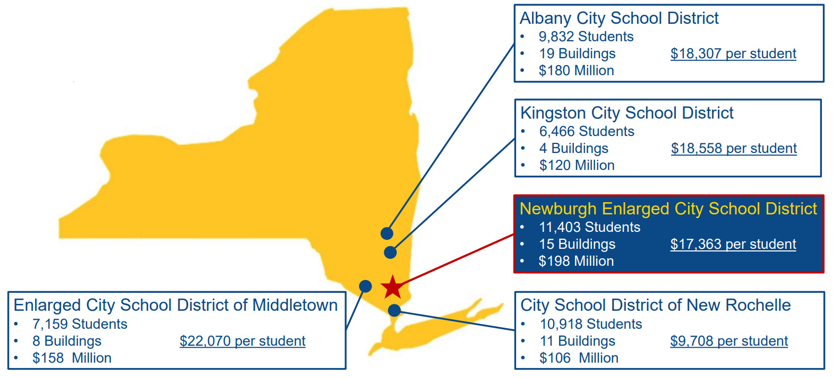
How does our bond compare to other city schools?

Slide 10
Balmville Elementary School

Slide 11
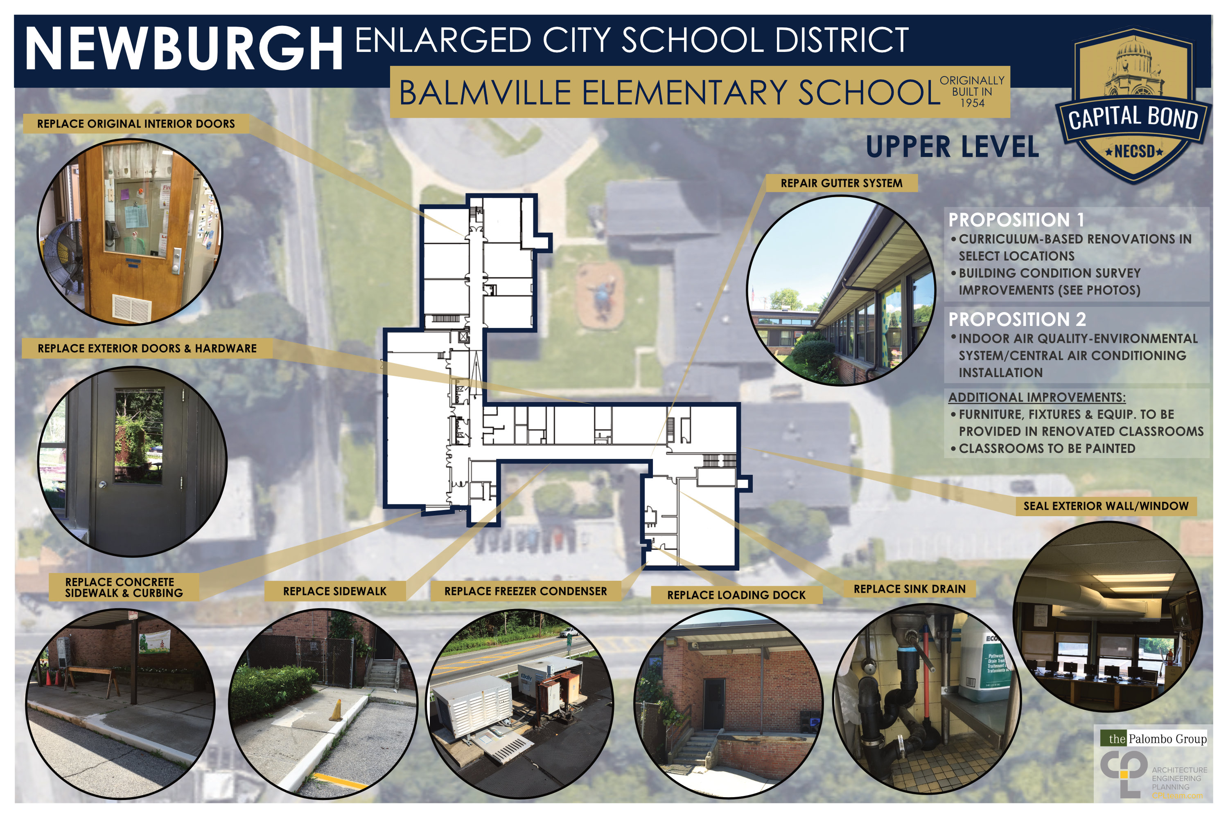
Balmville Elementary School

Slide 12
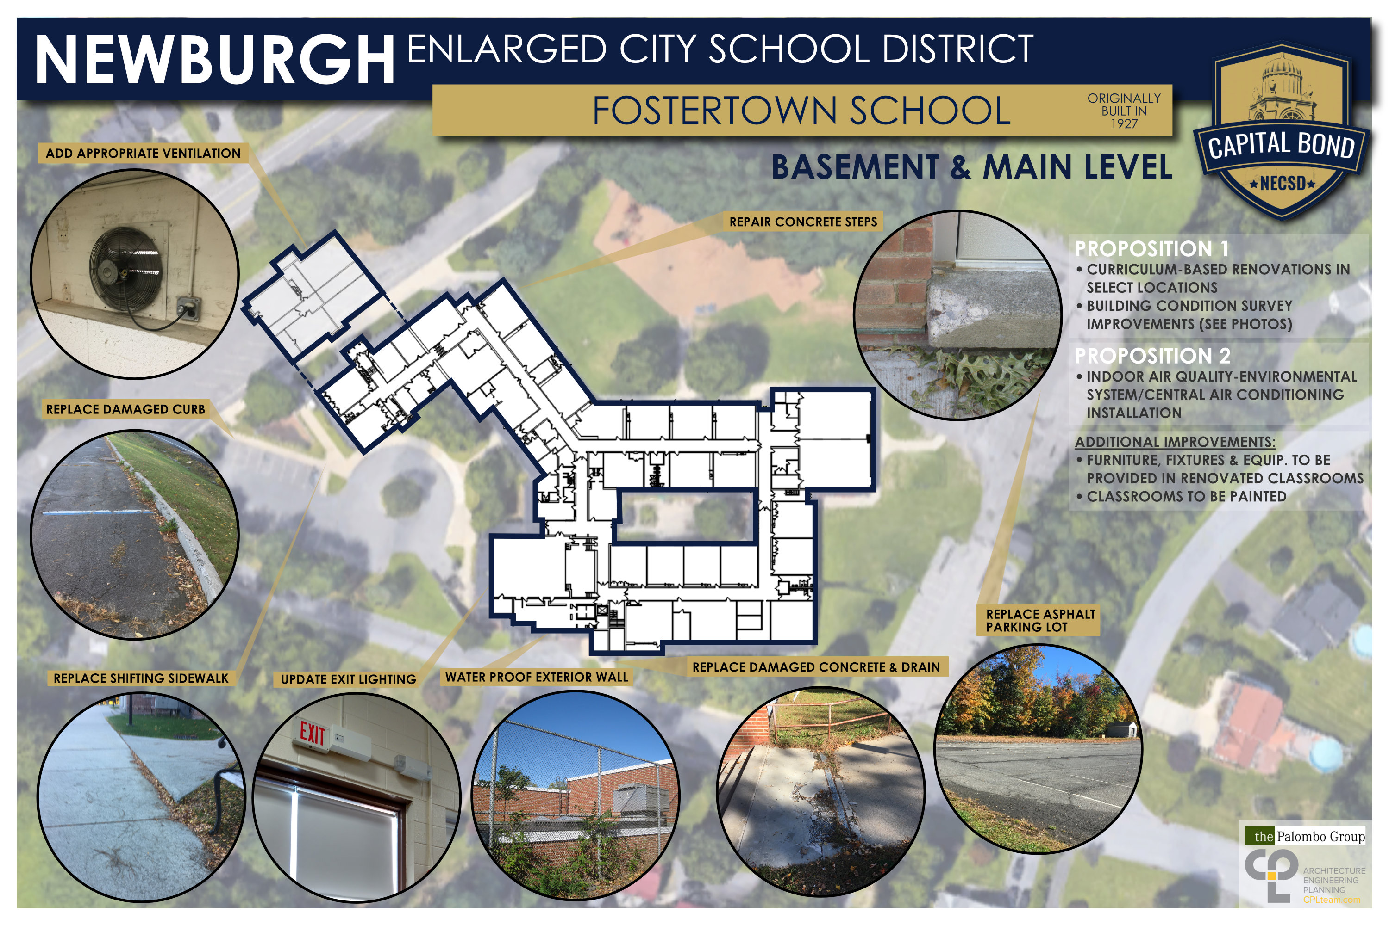
Fostertown School

Slide 13
Fostertown School

Slide 14
GAMS School

Slide 15
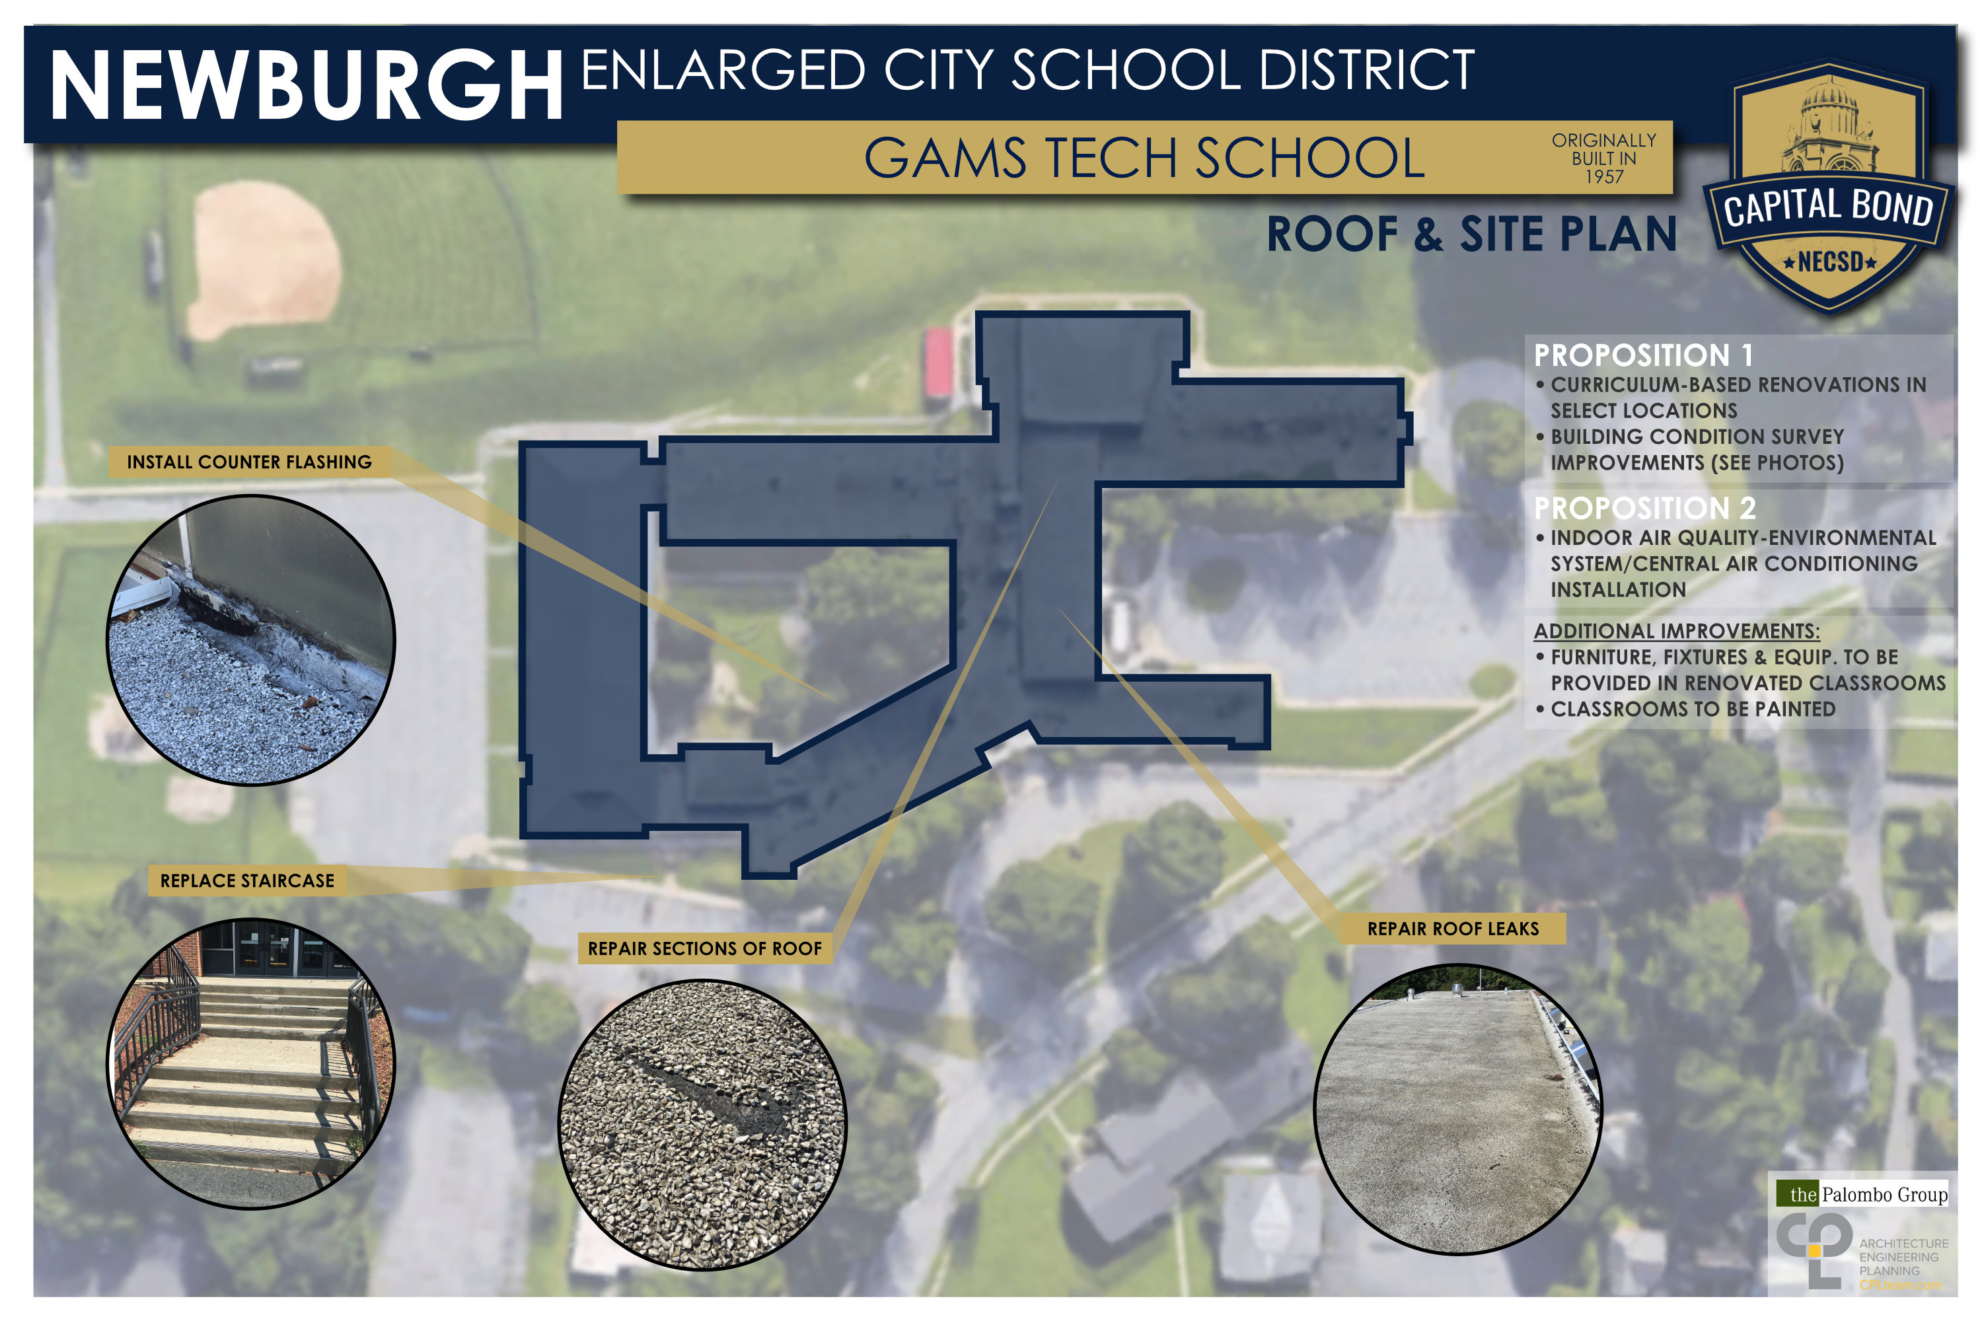
GAMS School

Slide 16
Gardnertown Leadership Academy

Slide 17
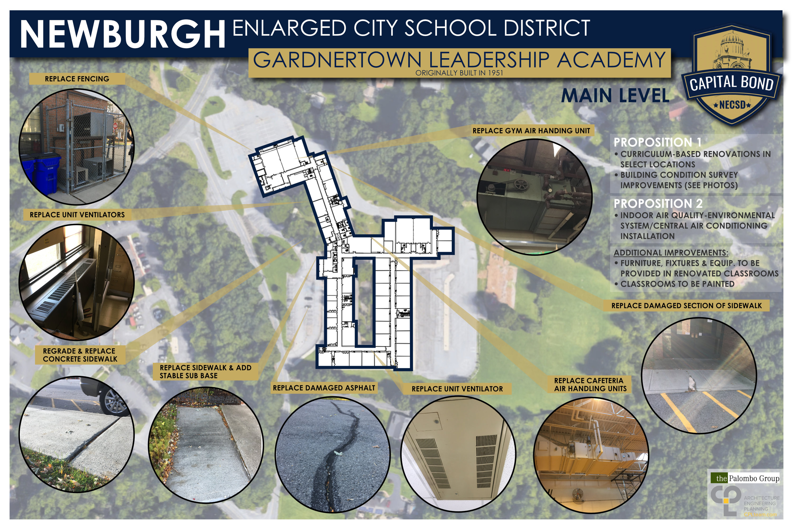
Gardnertown Leadership Academy

Slide 18
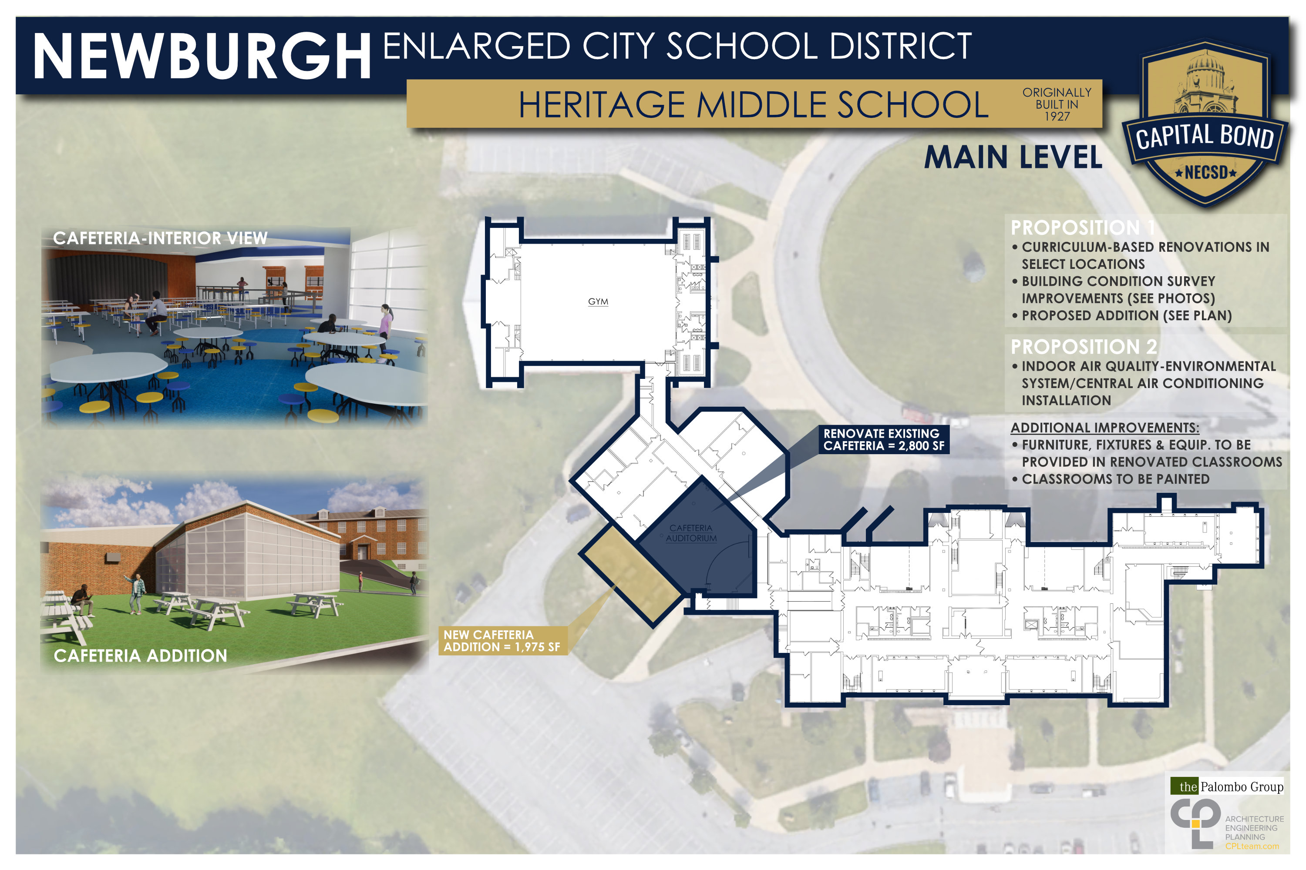
Heritage Middle School

Slide 19
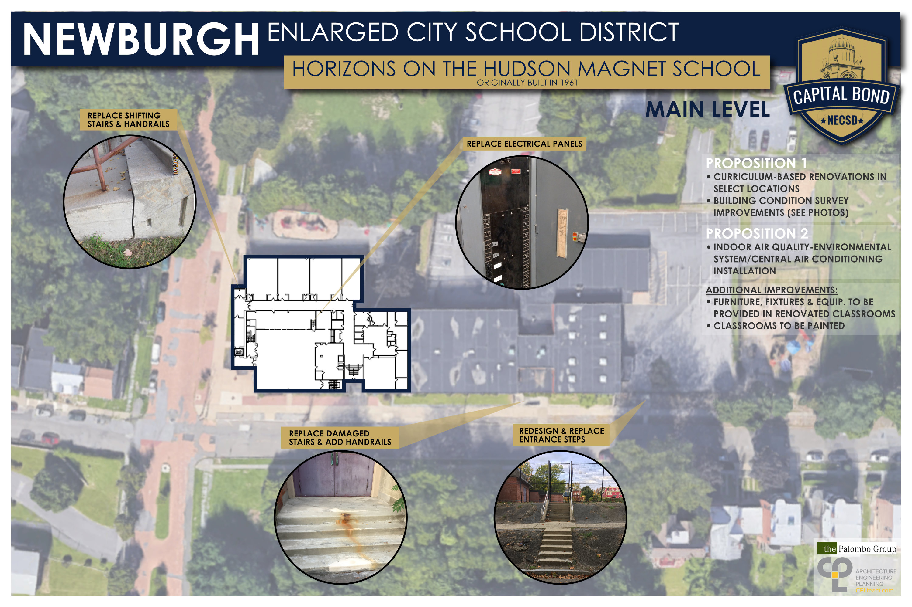
Horizons on the Hudson Elementary School

Slide 20
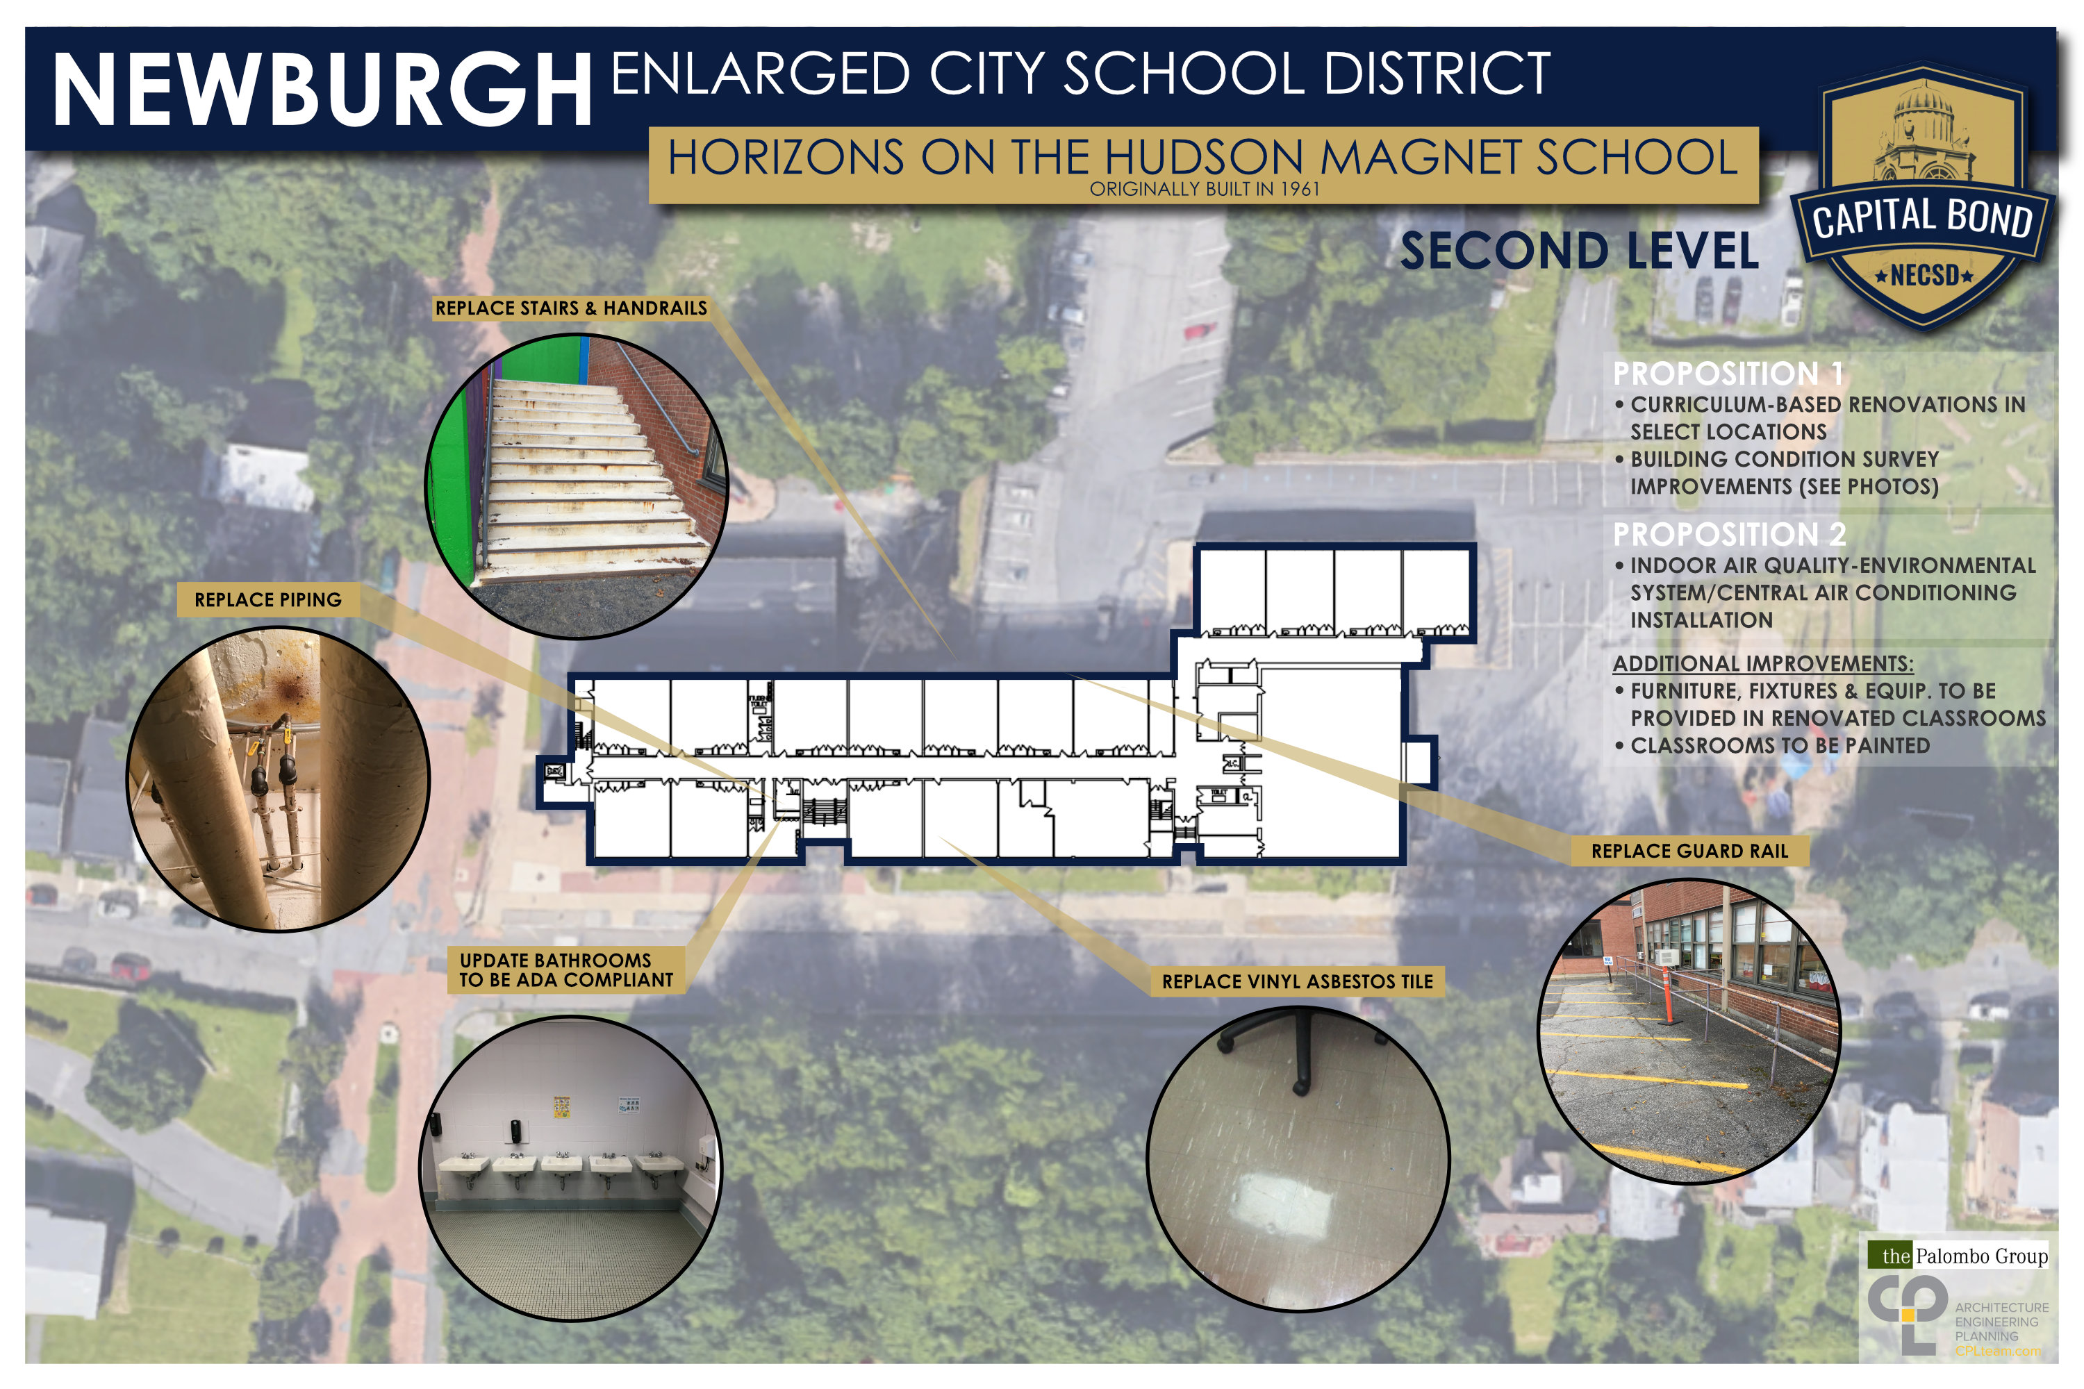
Horizons on the Hudson Elementary School

Slide 21
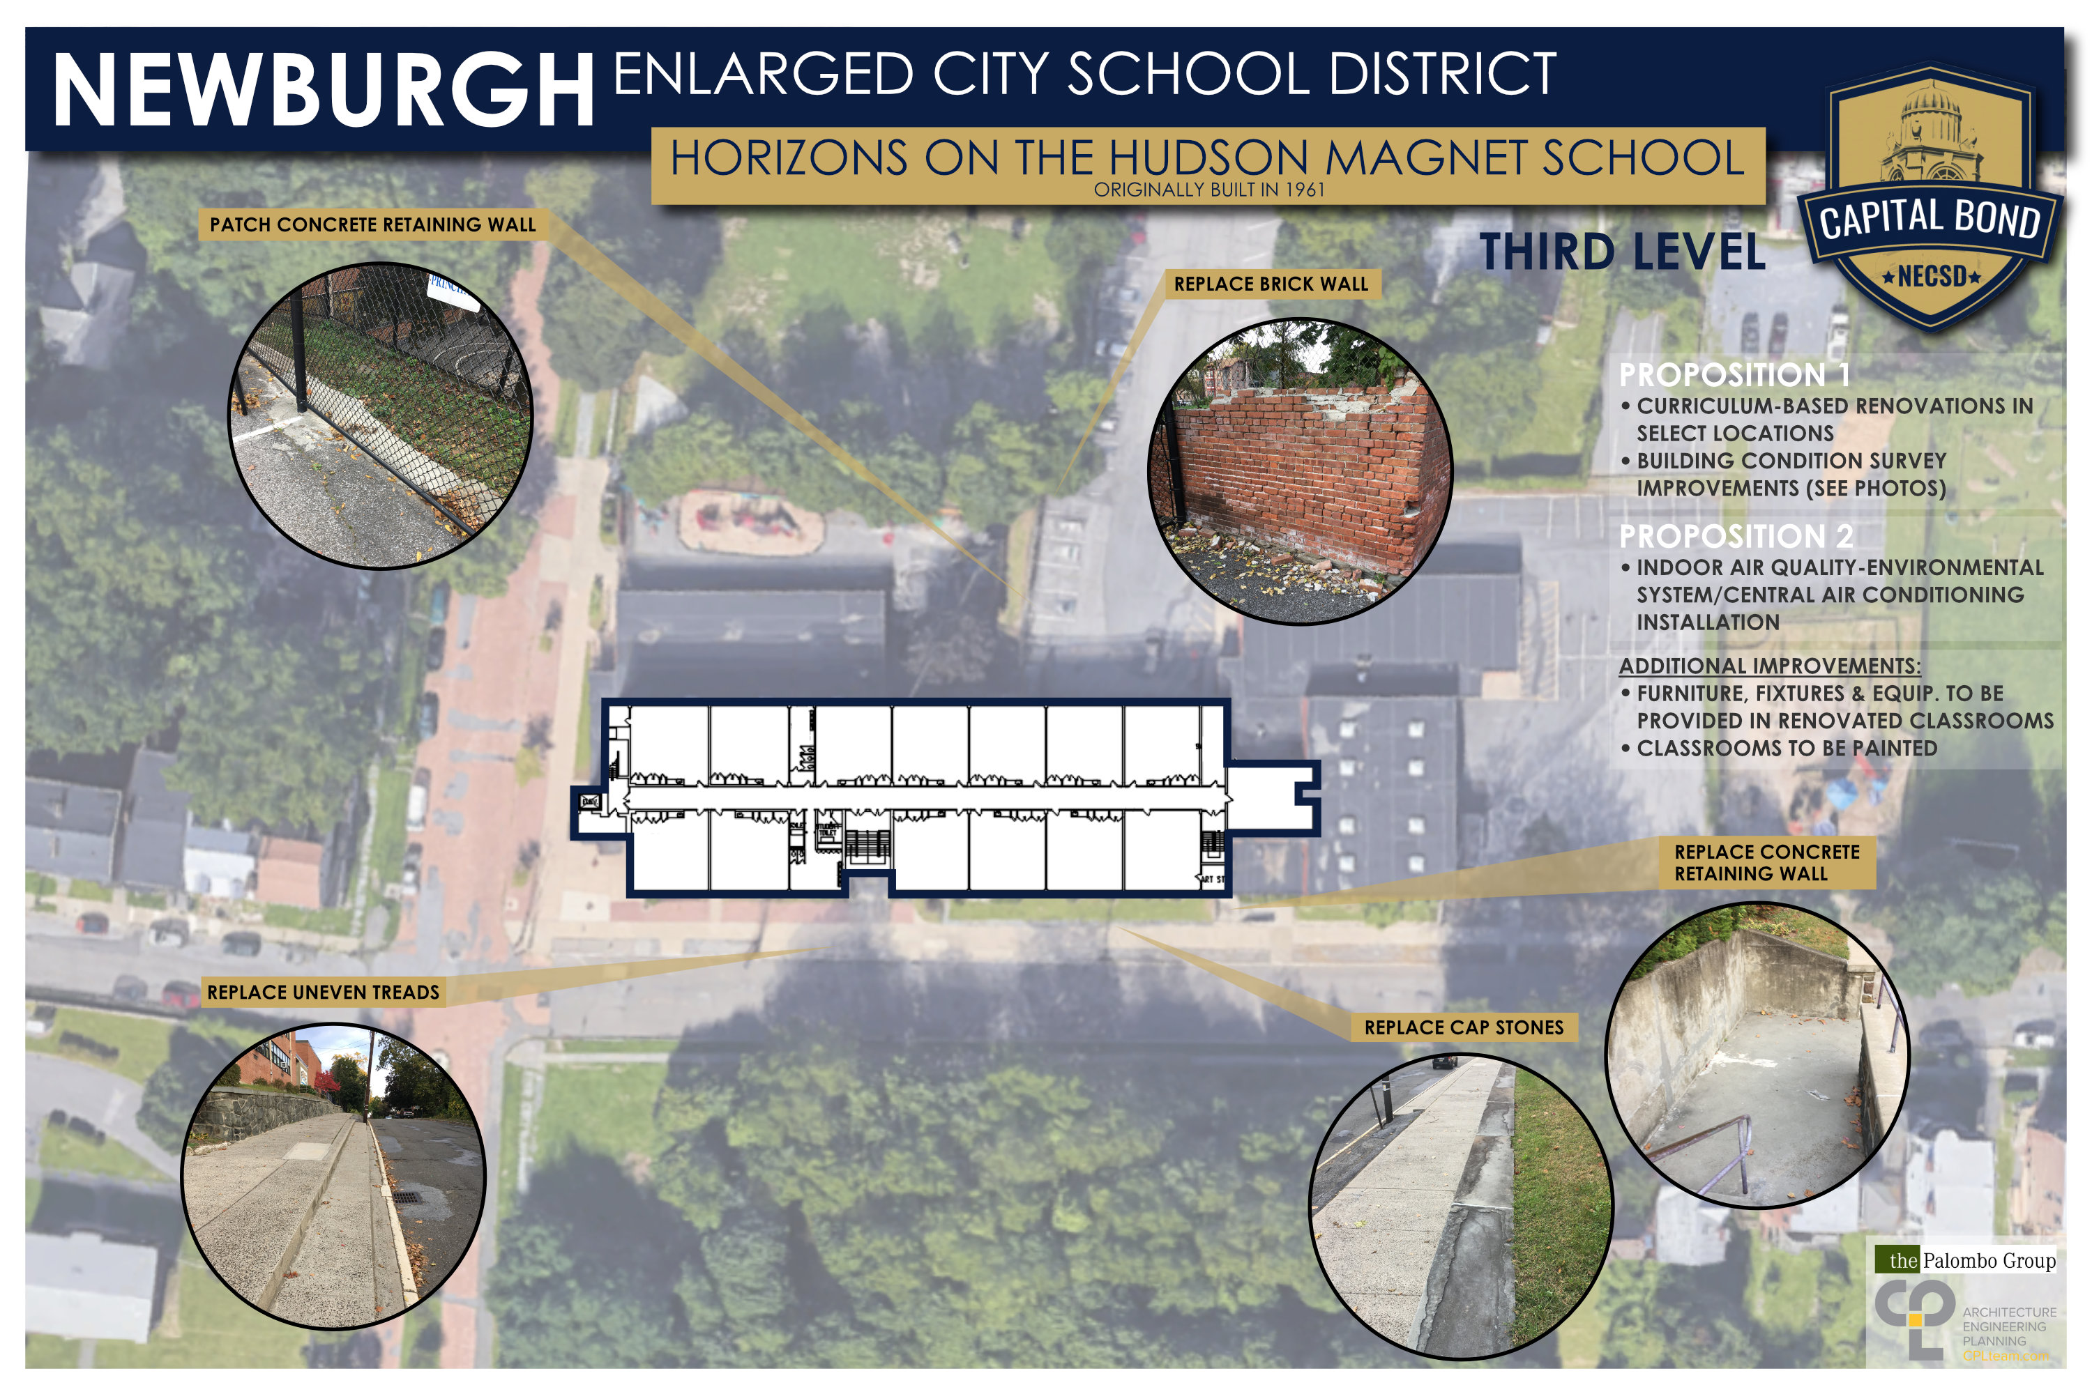
Horizons on the Hudson Elementary School

Slide 22
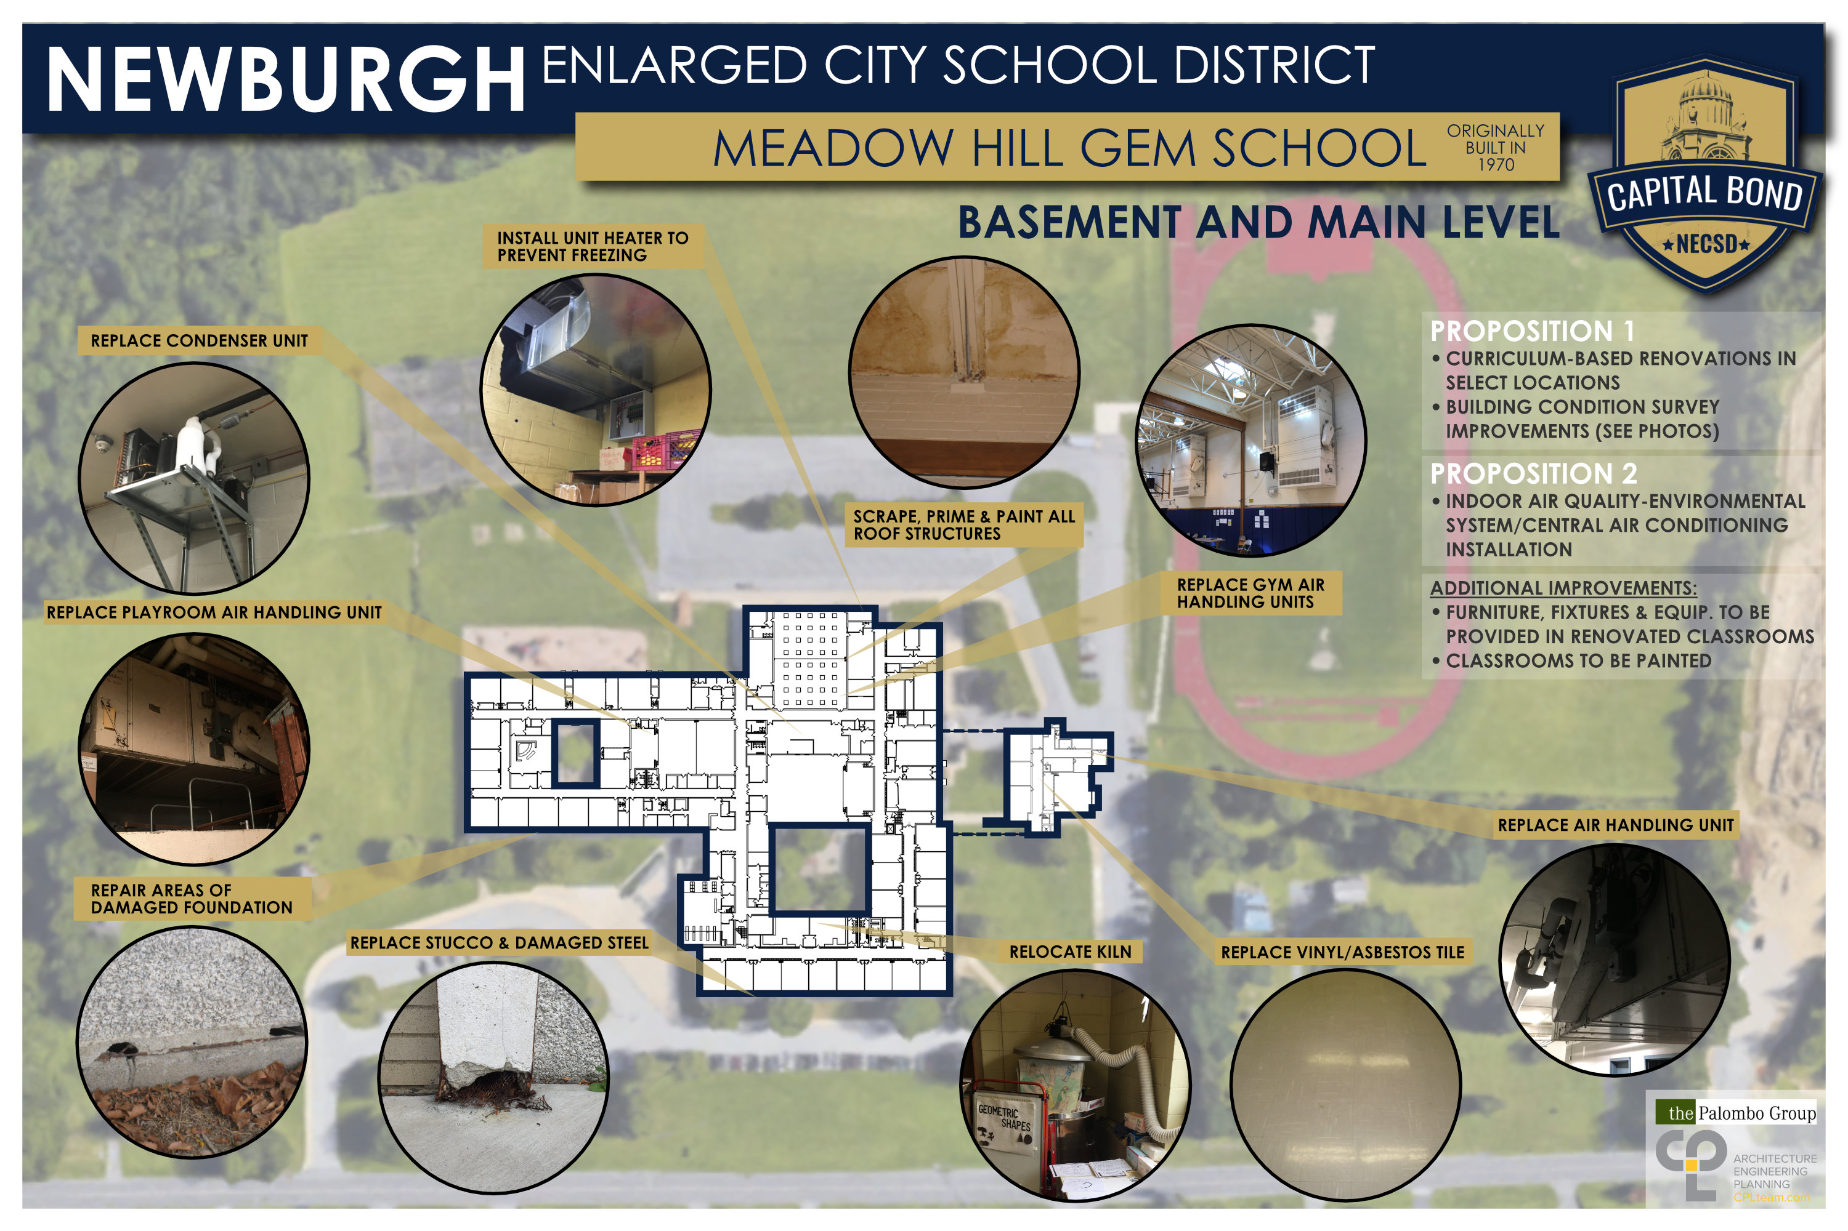
Meadow Hill Elementary School

Slide 23
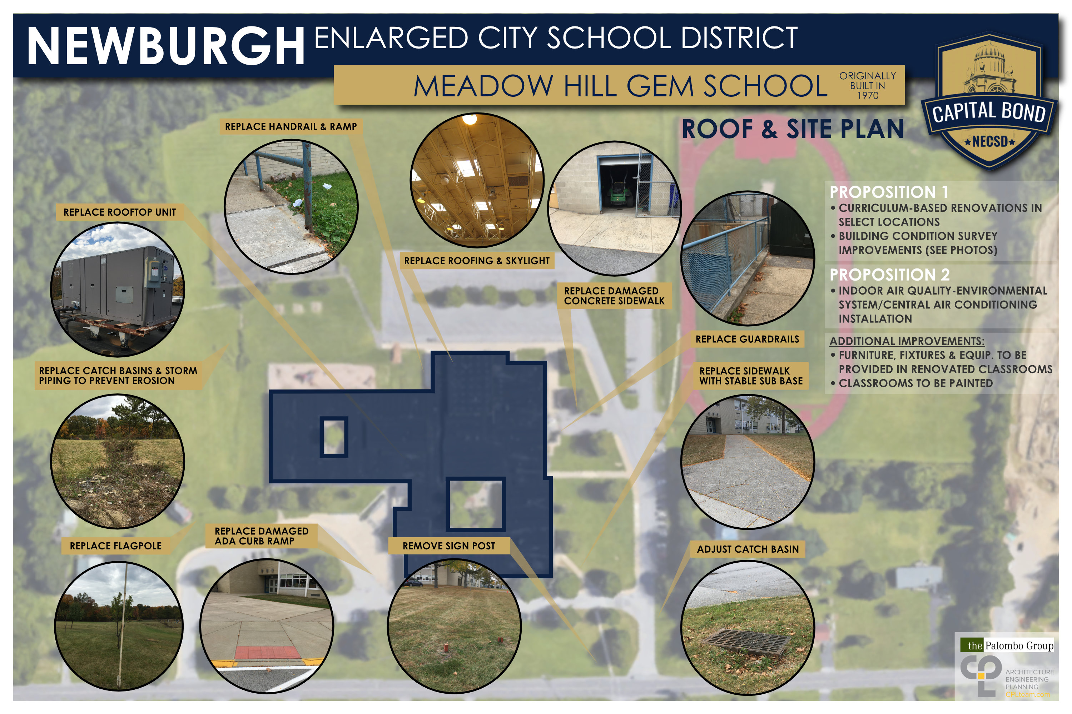
Meadow Hill Elementary School

Slide 24
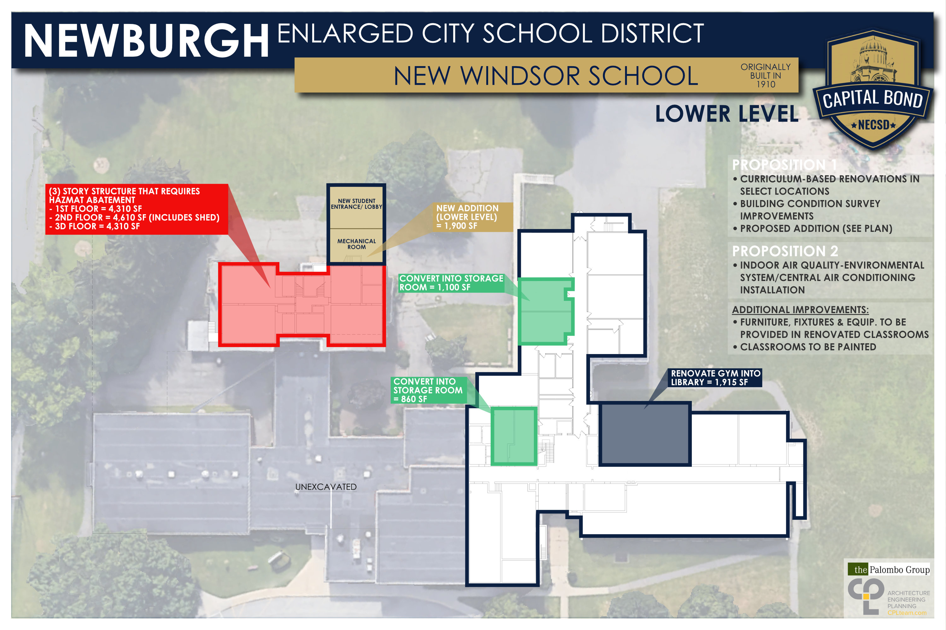
New Windsor School

Slide 25
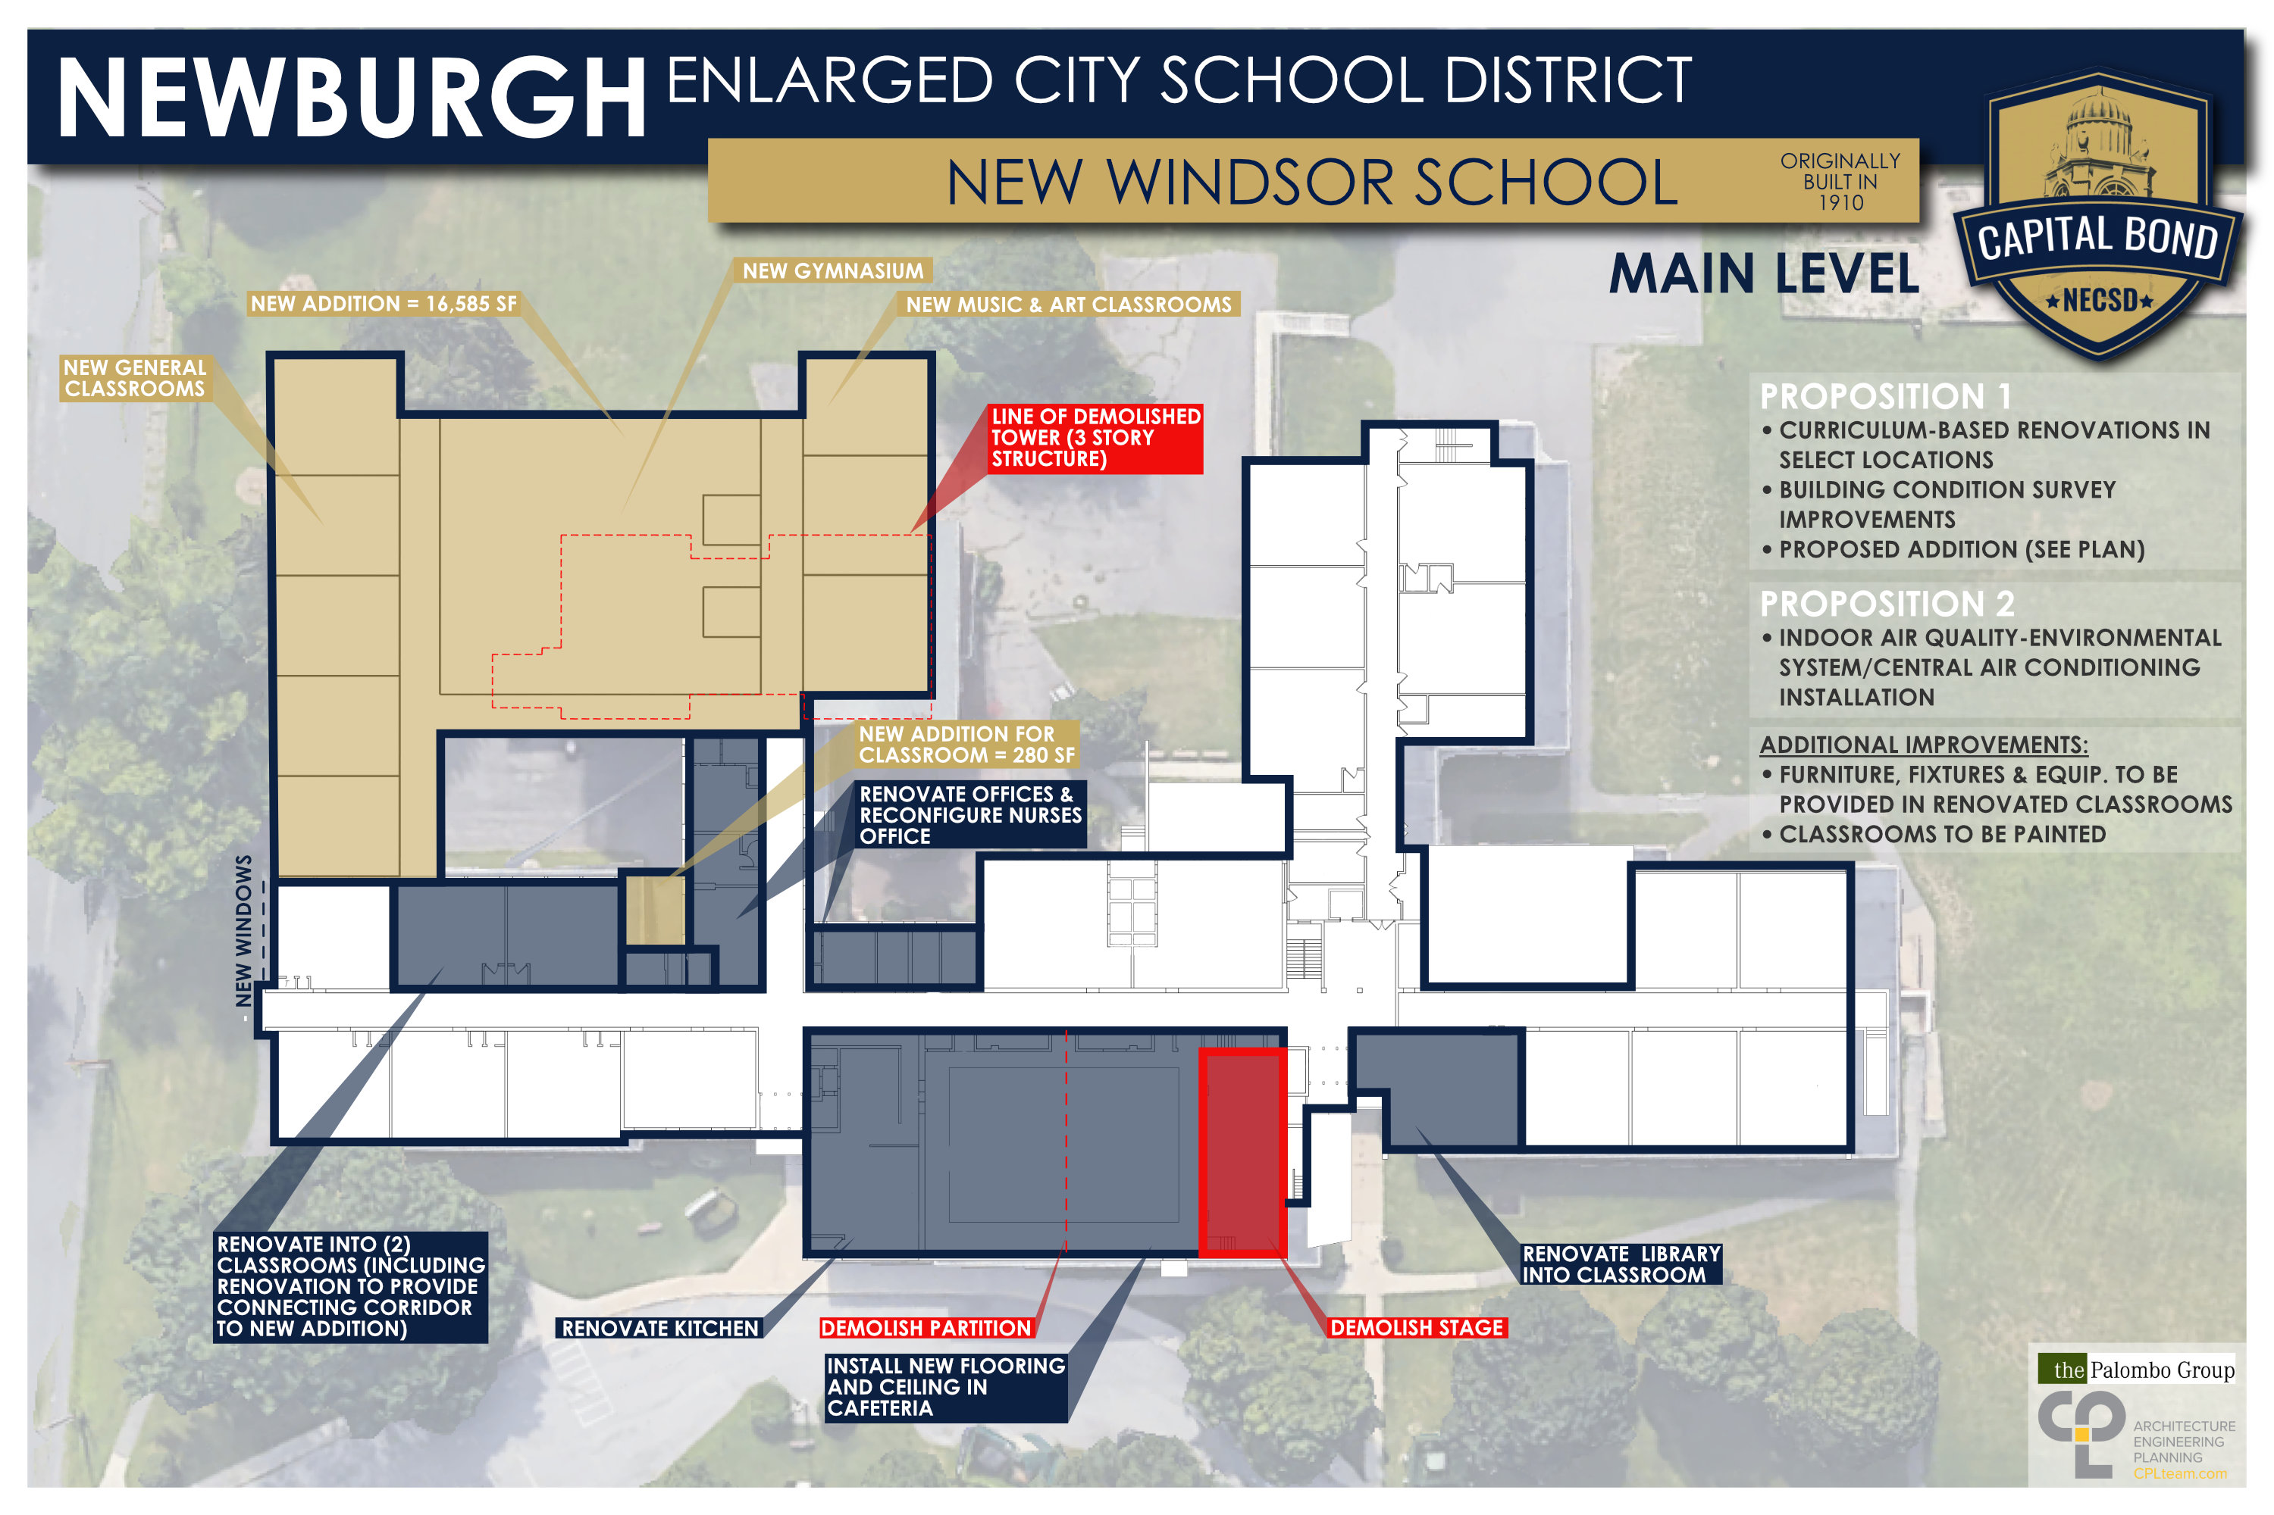
New Windsor School

Slide 26
New Windsor School

Slide 27
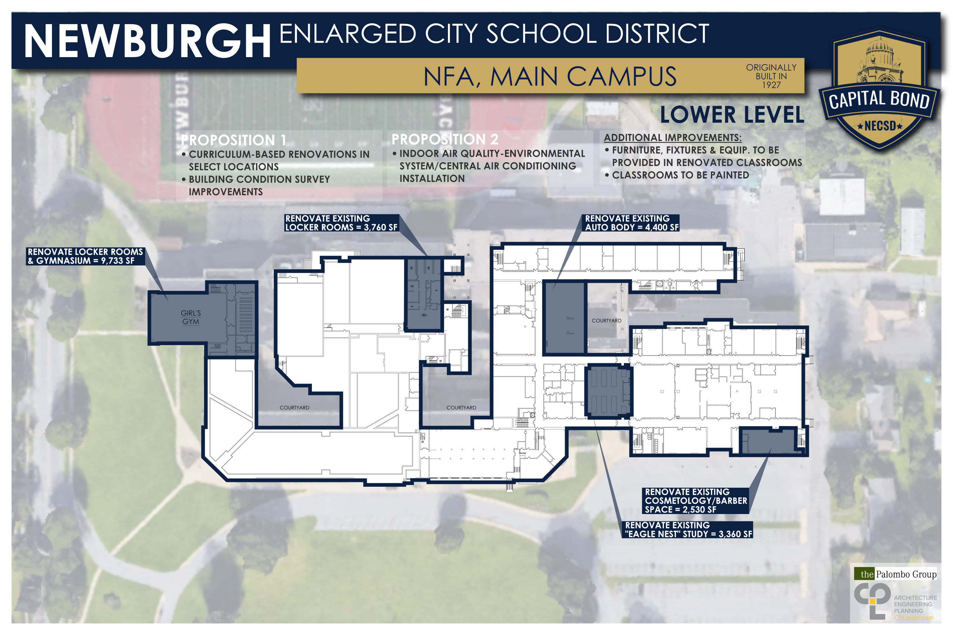
NFA Main Campus

Slide 28
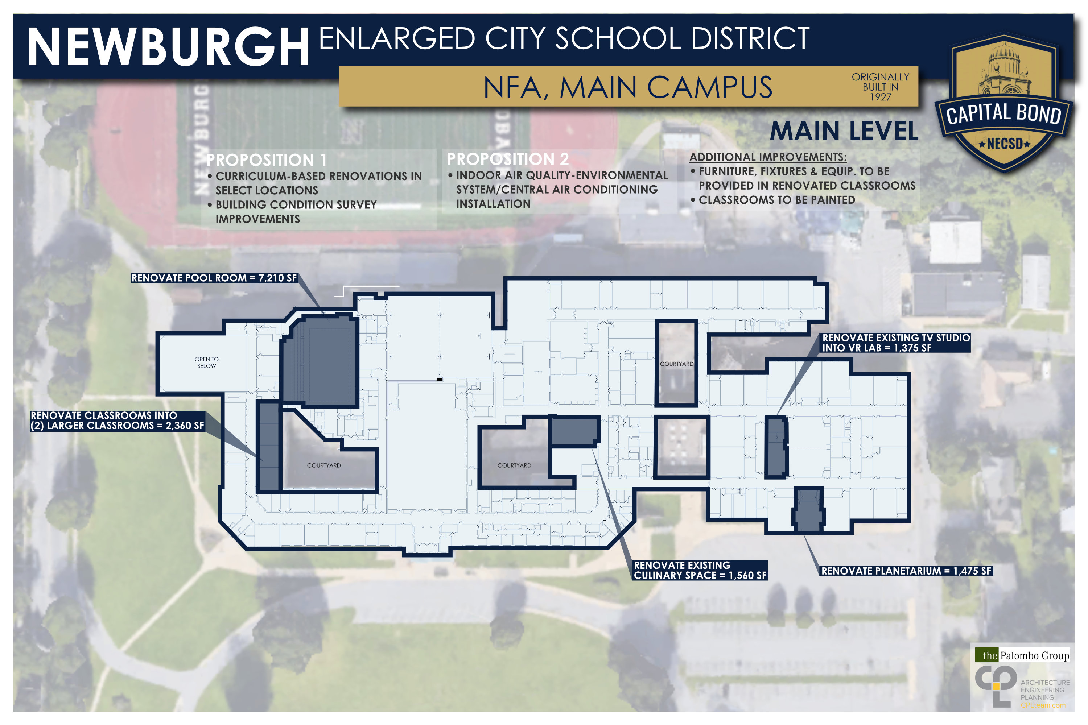
NFA Main Campus

Slide 29
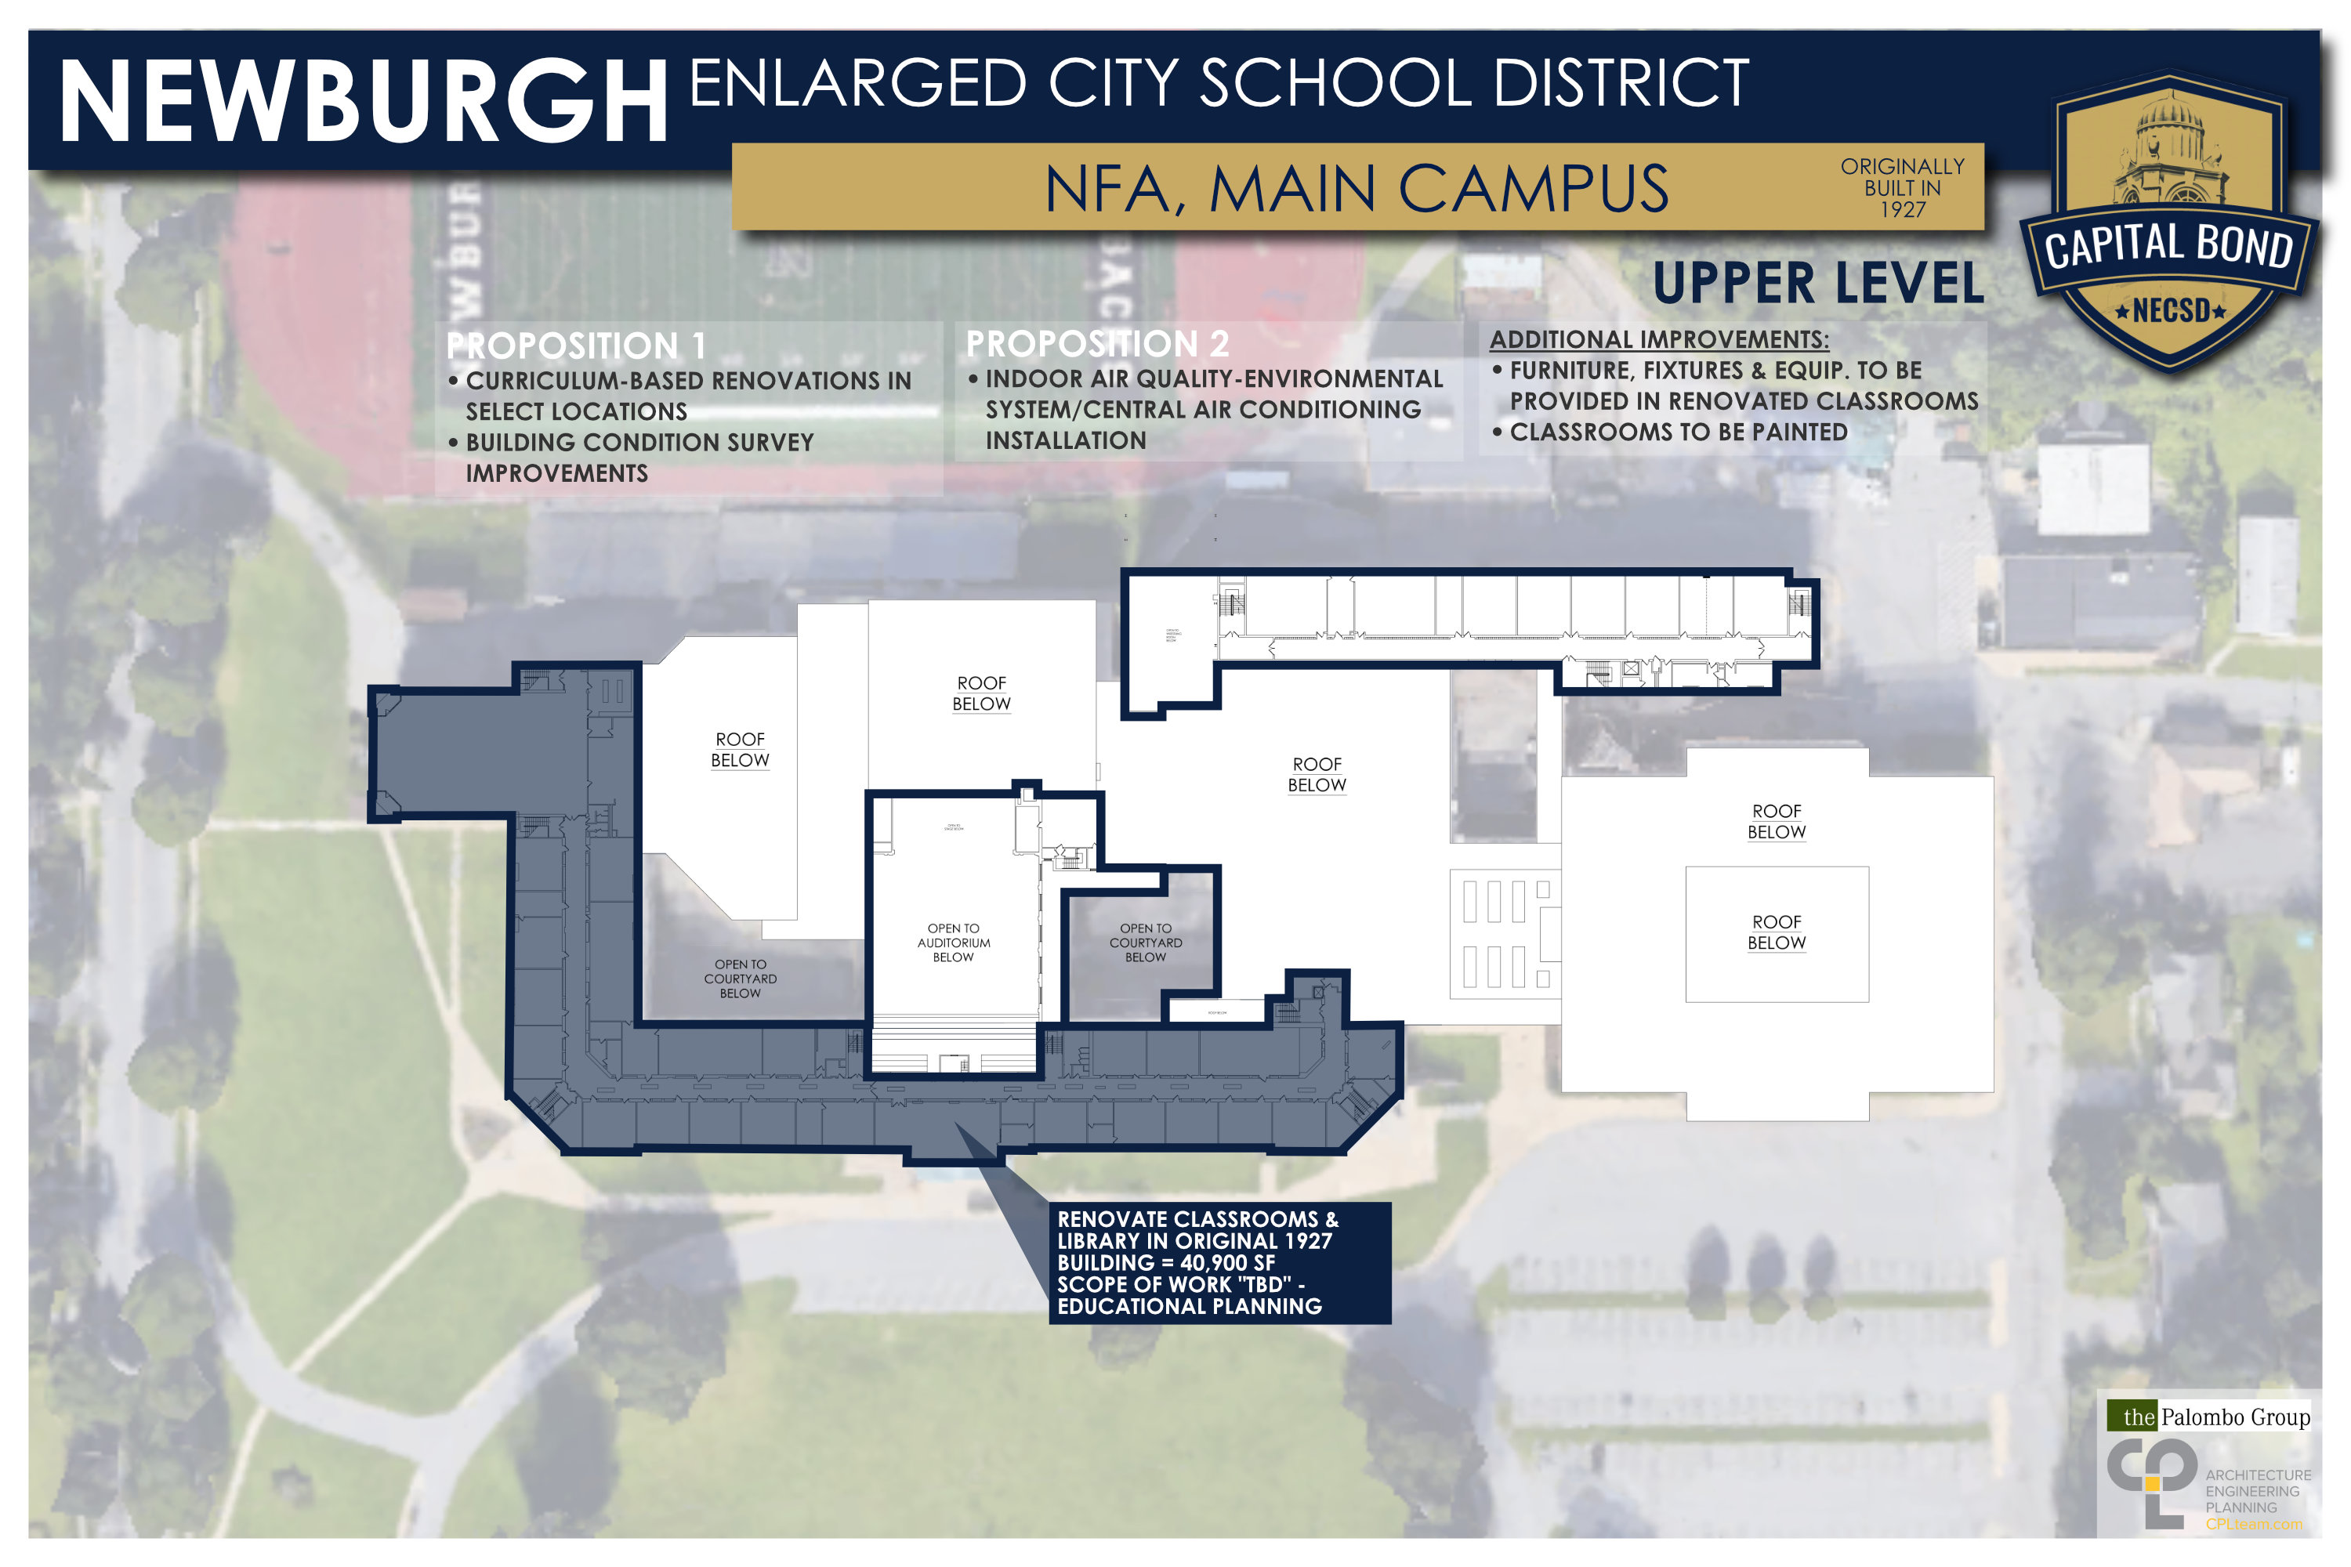
NFA Main Campus

Slide 30
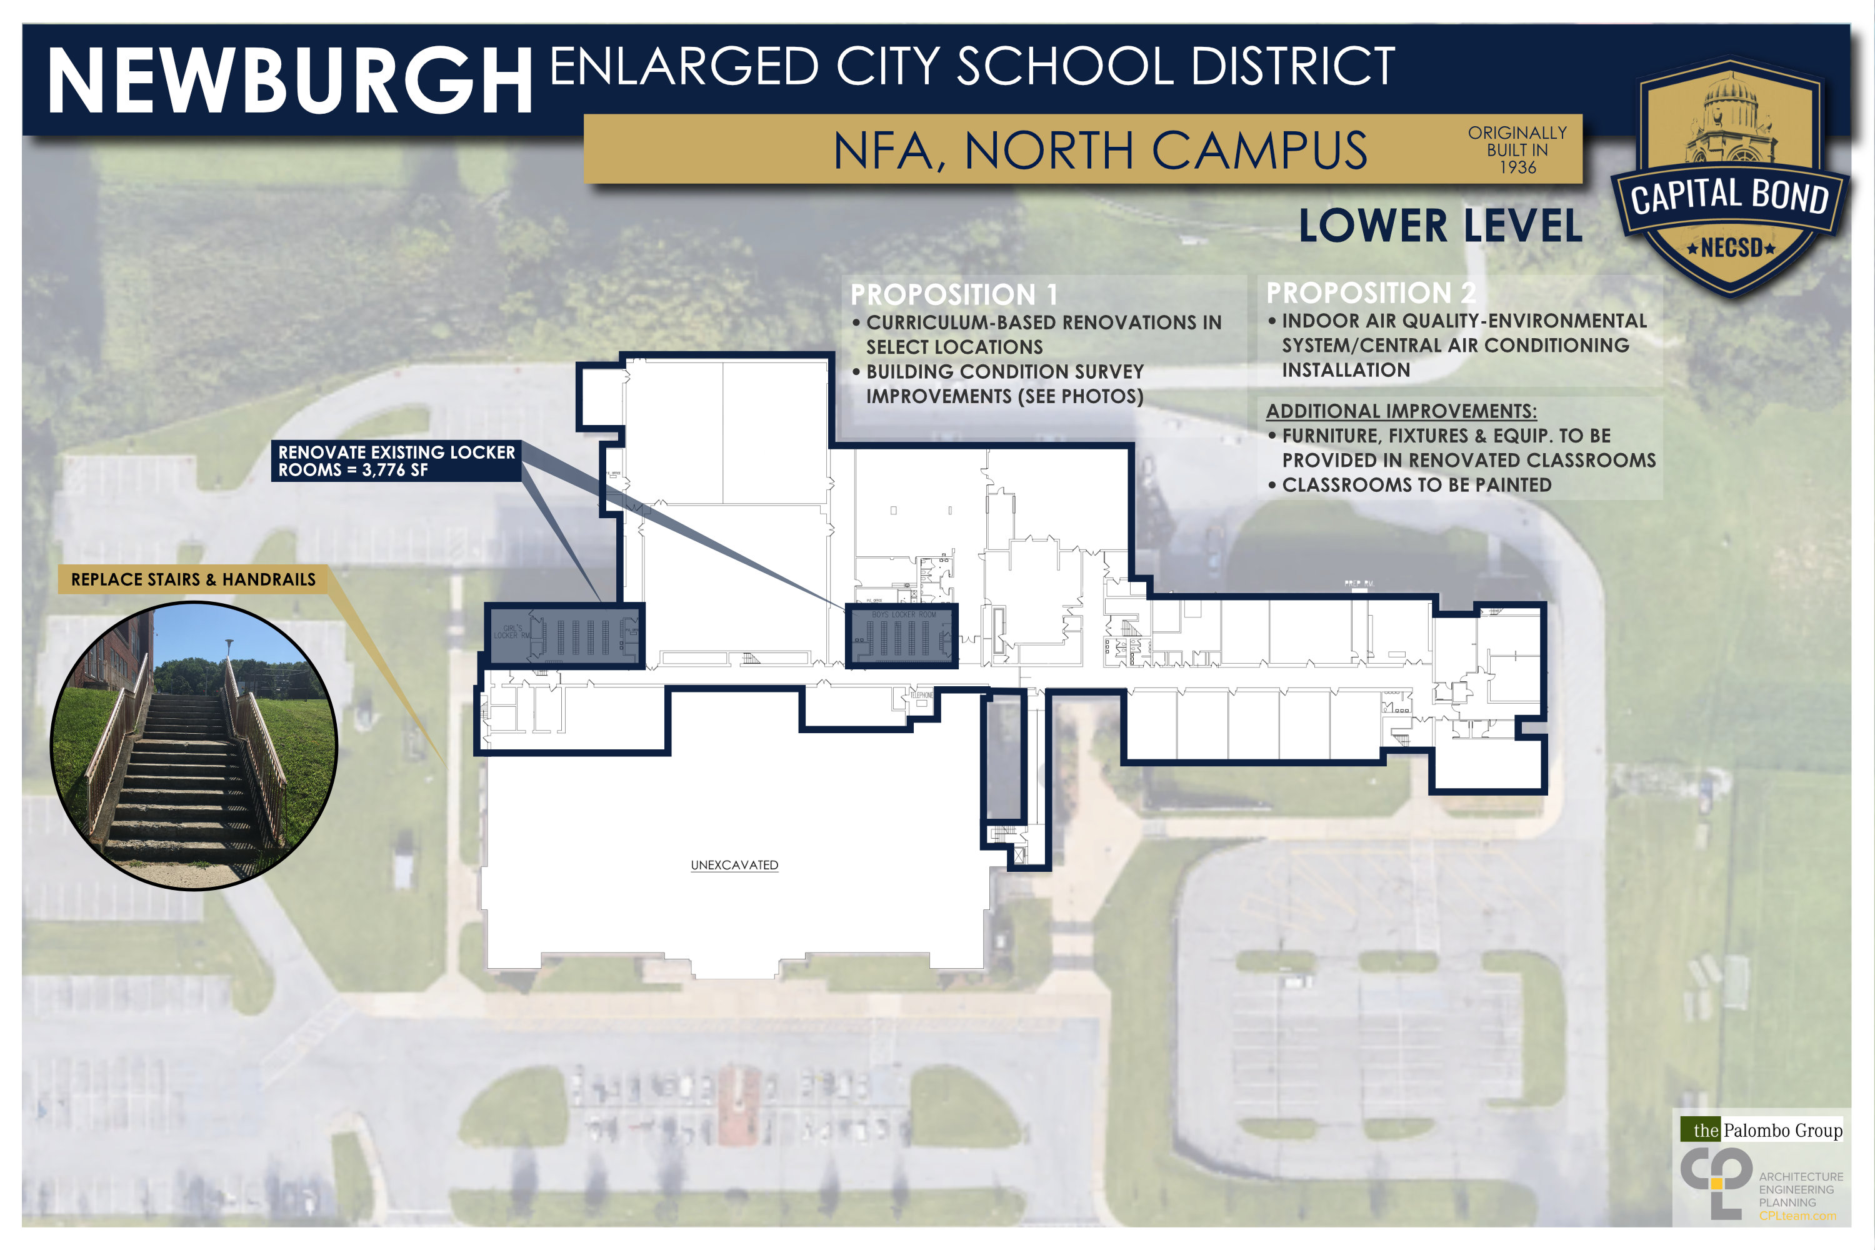
NFA North Campus

Slide 31
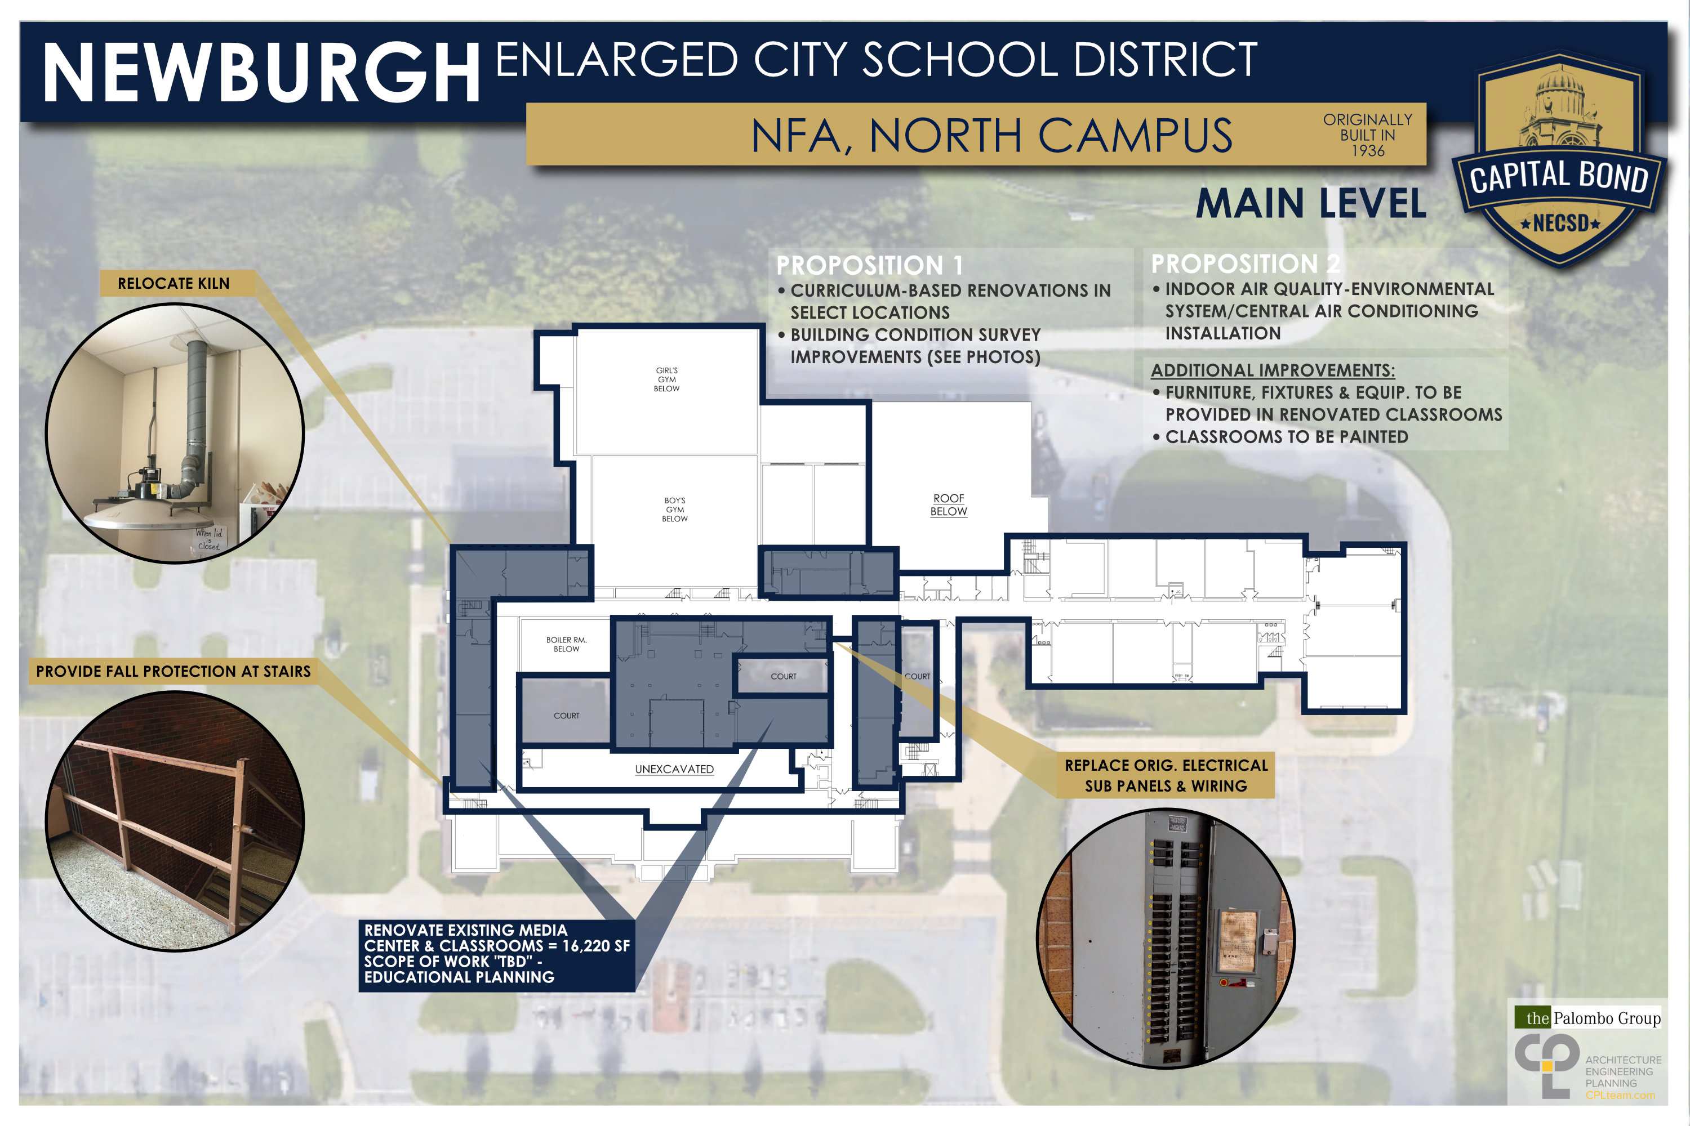
NFA North Campus

Slide 32
NFA North Campus

Slide 33
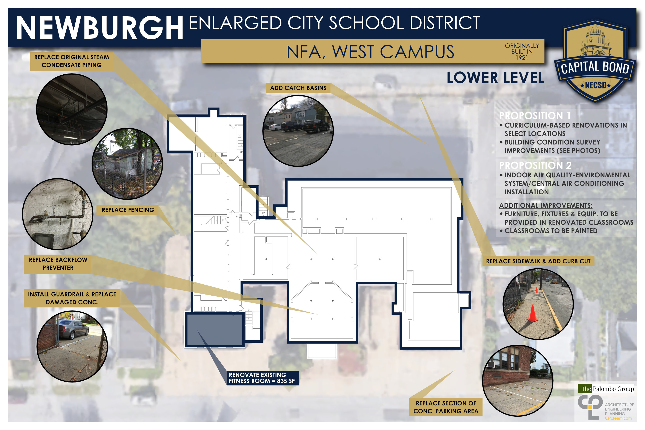
NFA West Campus

Slide 34
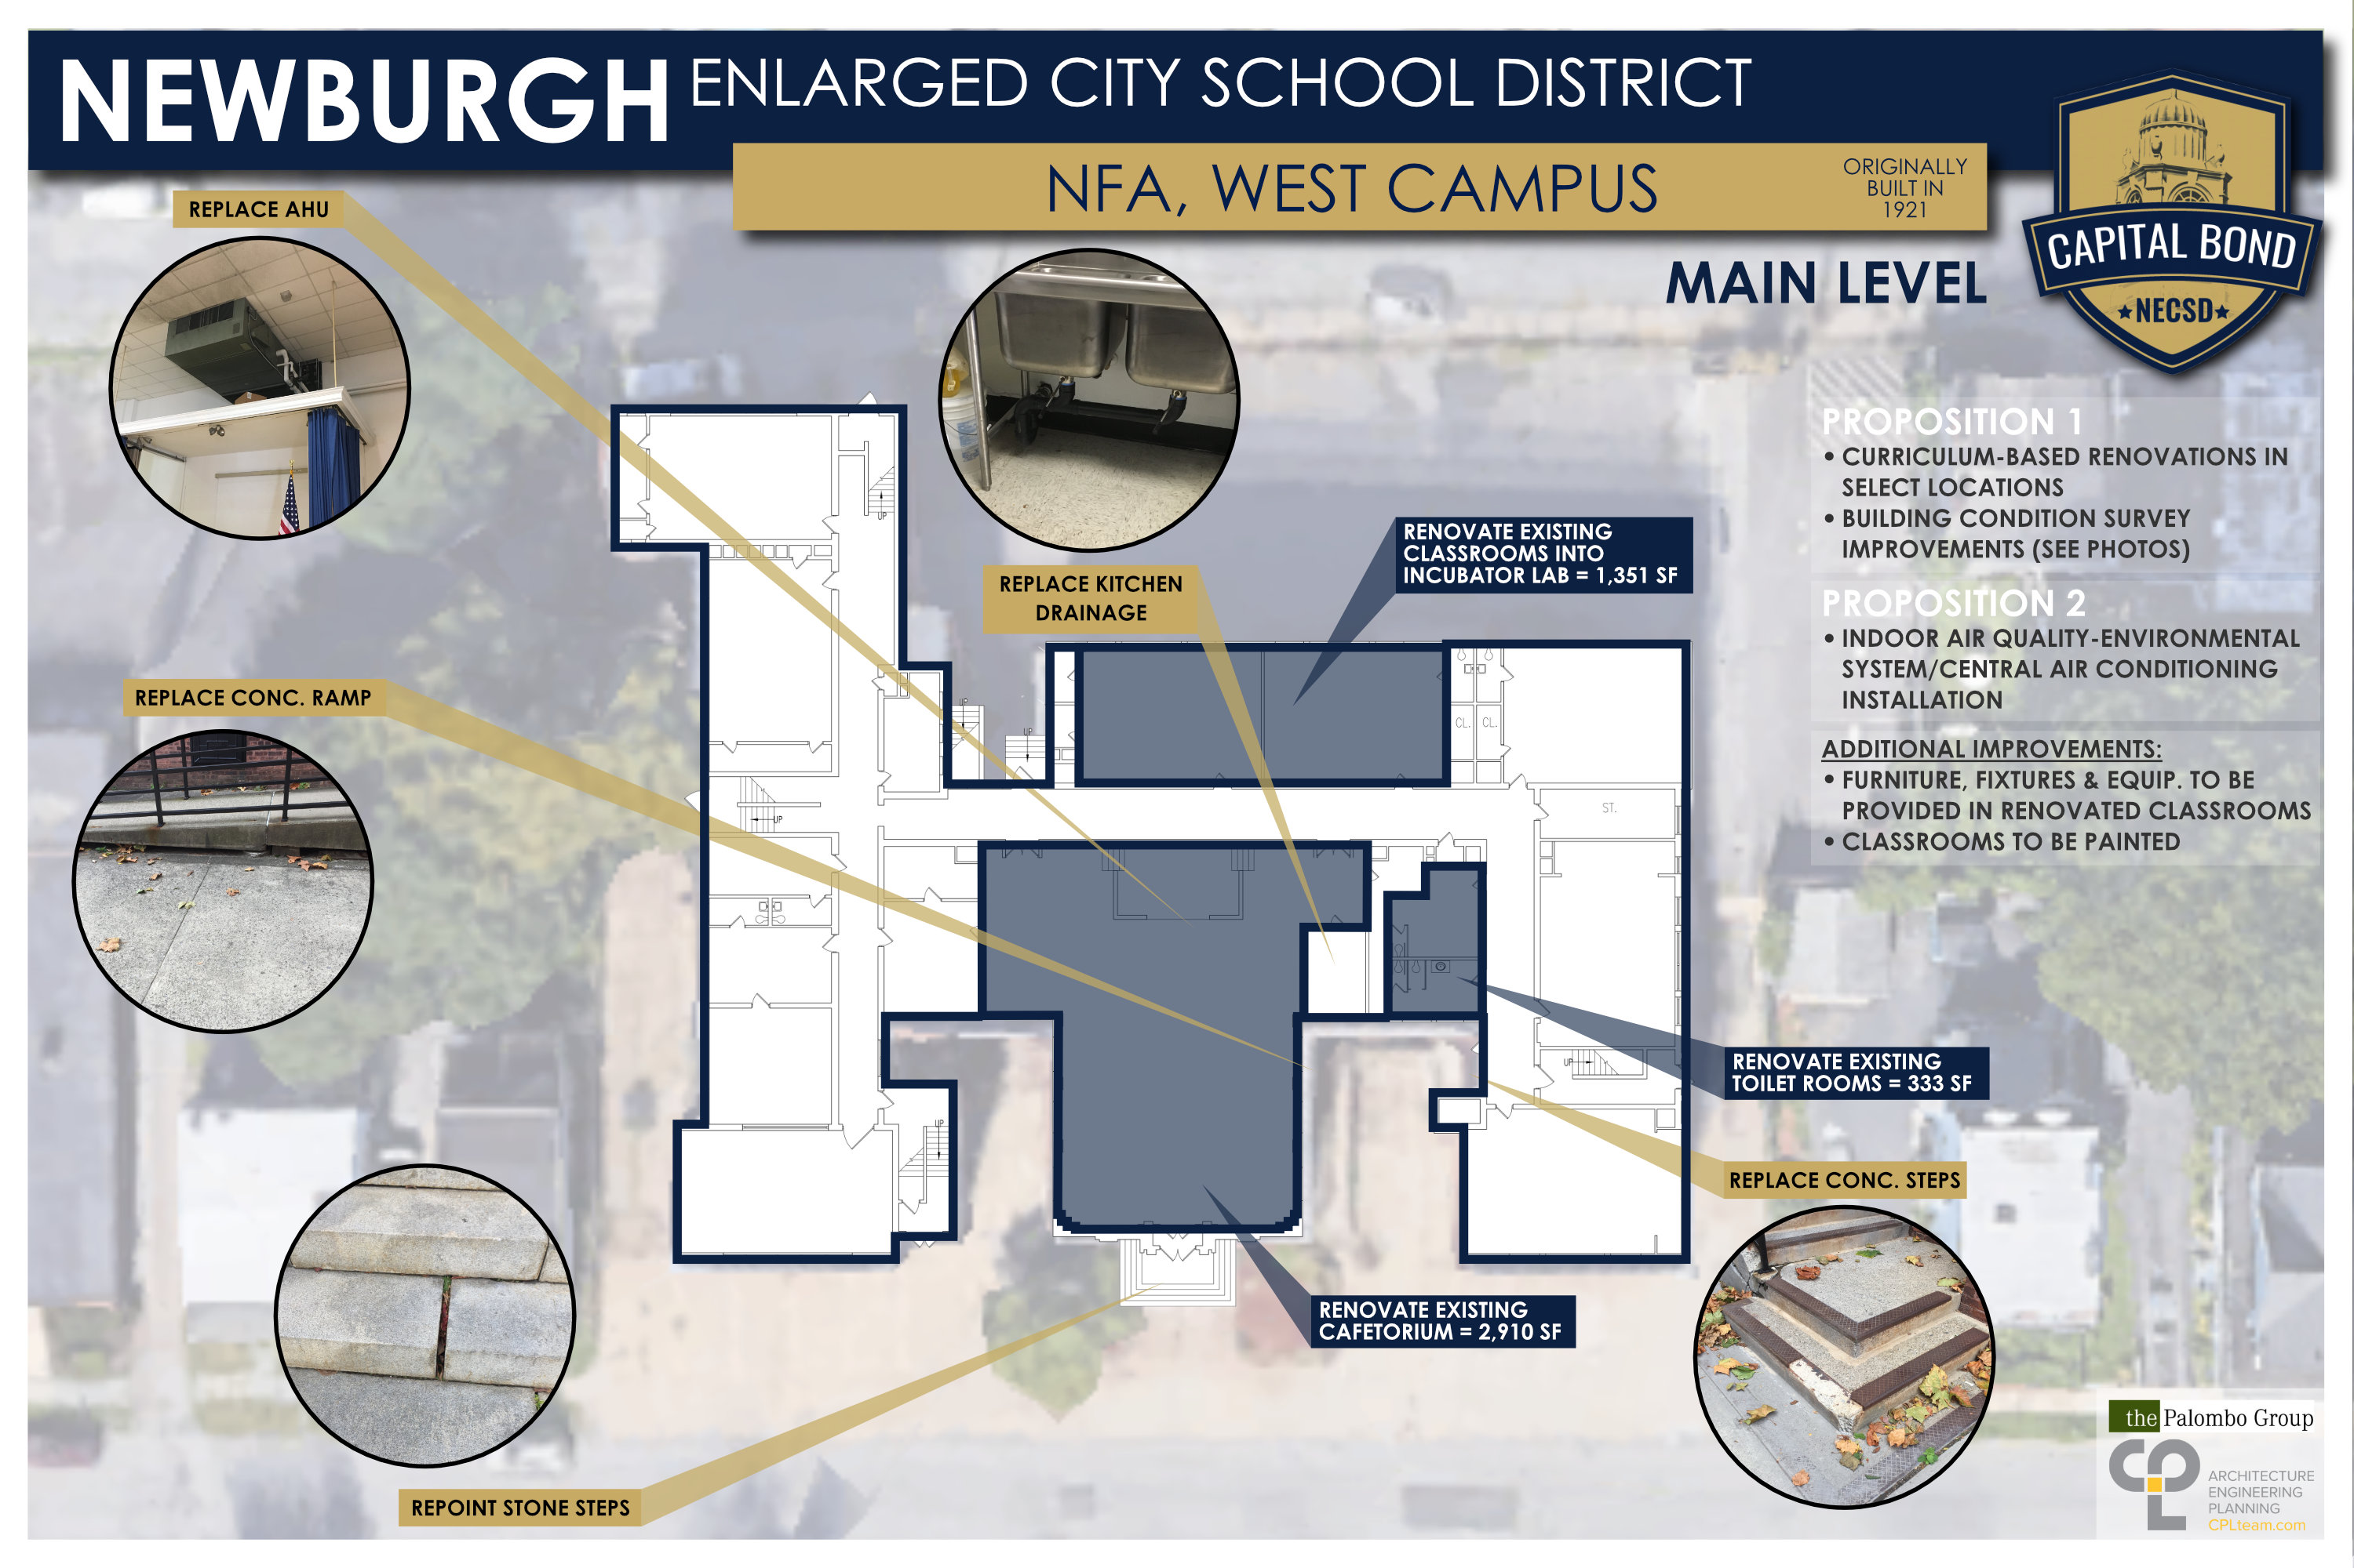
NFA West Campus

Slide 35
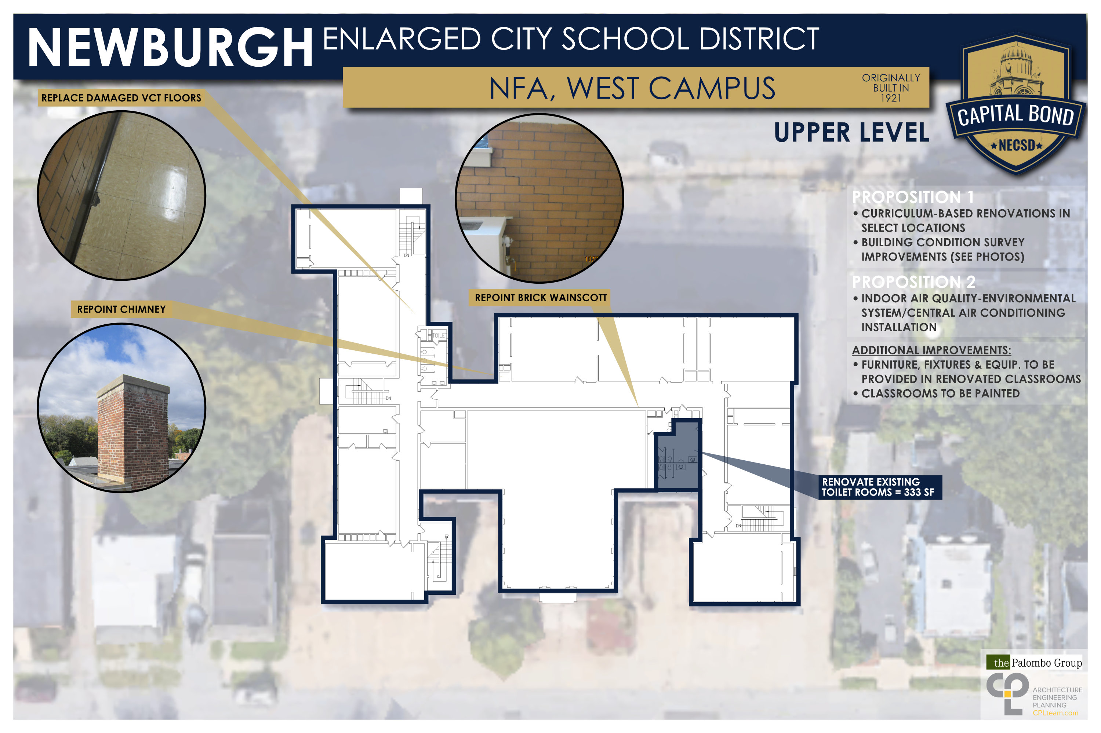
NFA West Campus

Slide 36
South Middle School

Slide 37
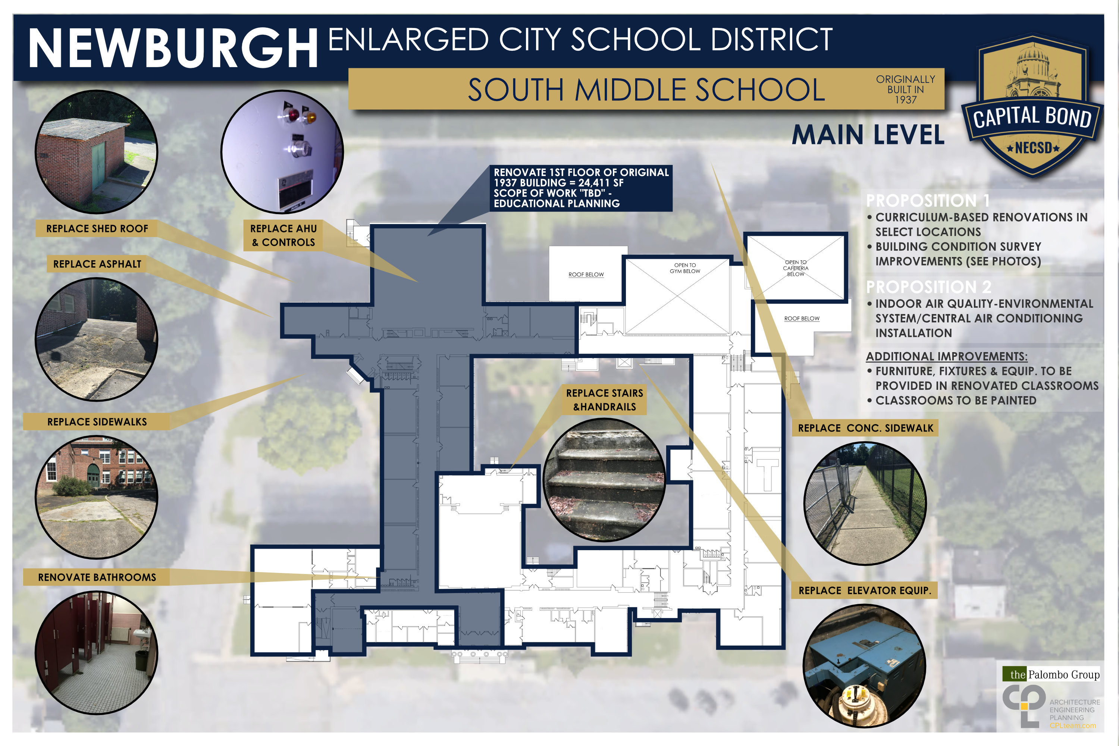
South Middle School

Slide 38
South Middle School

Slide 39
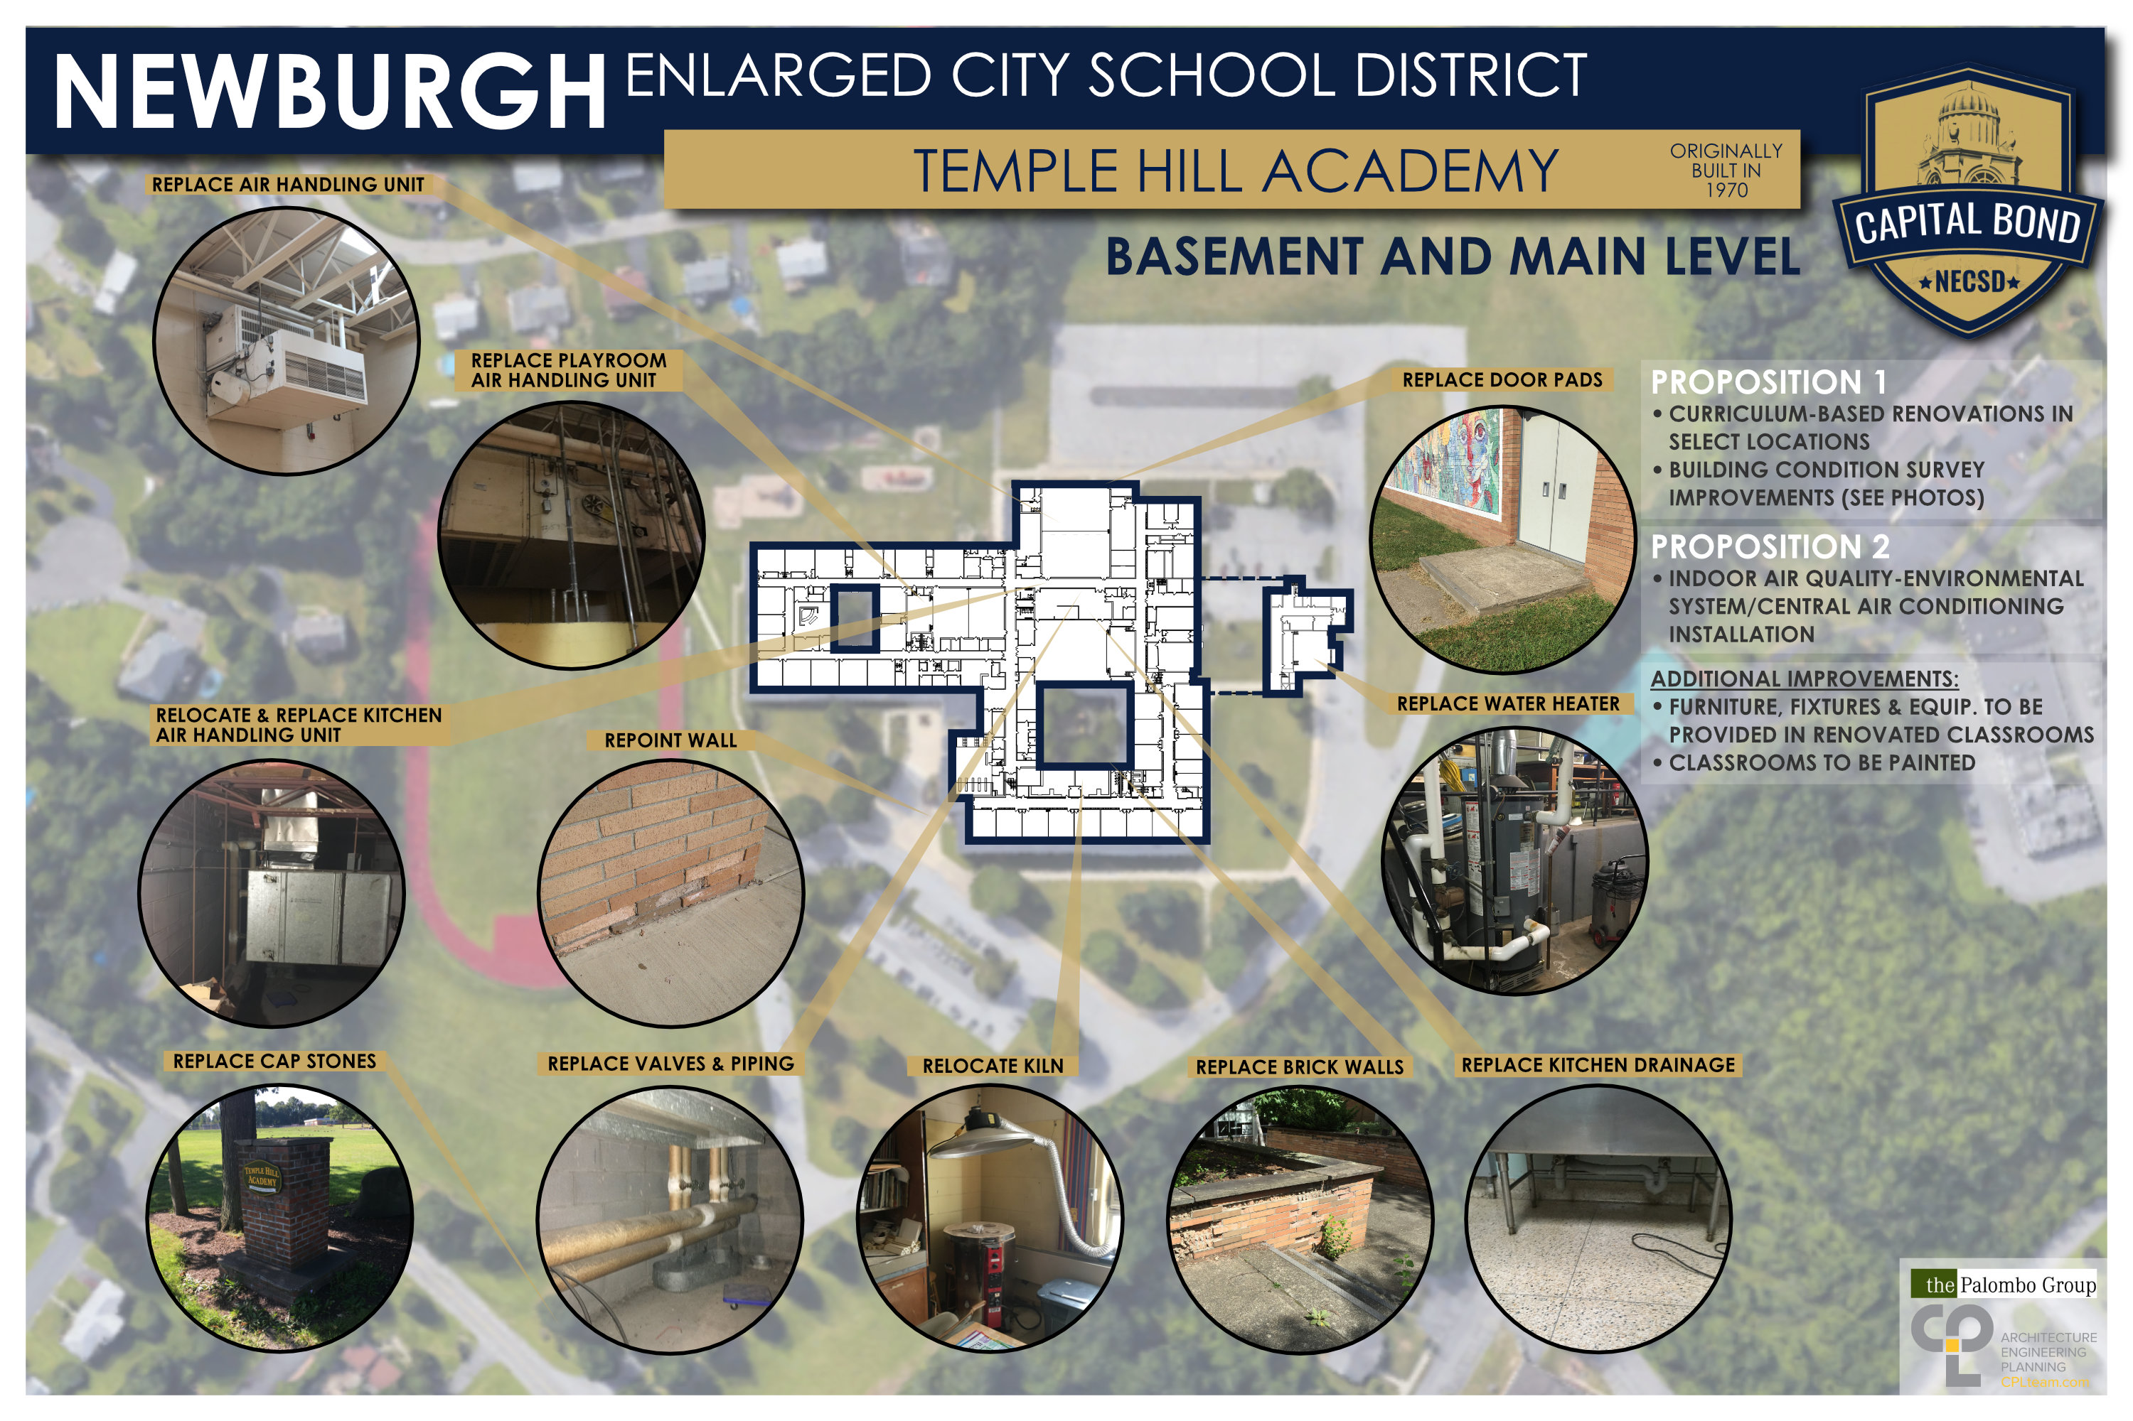
Temple Hill Academy

Slide 40
Temple Hill Academy

Slide 41
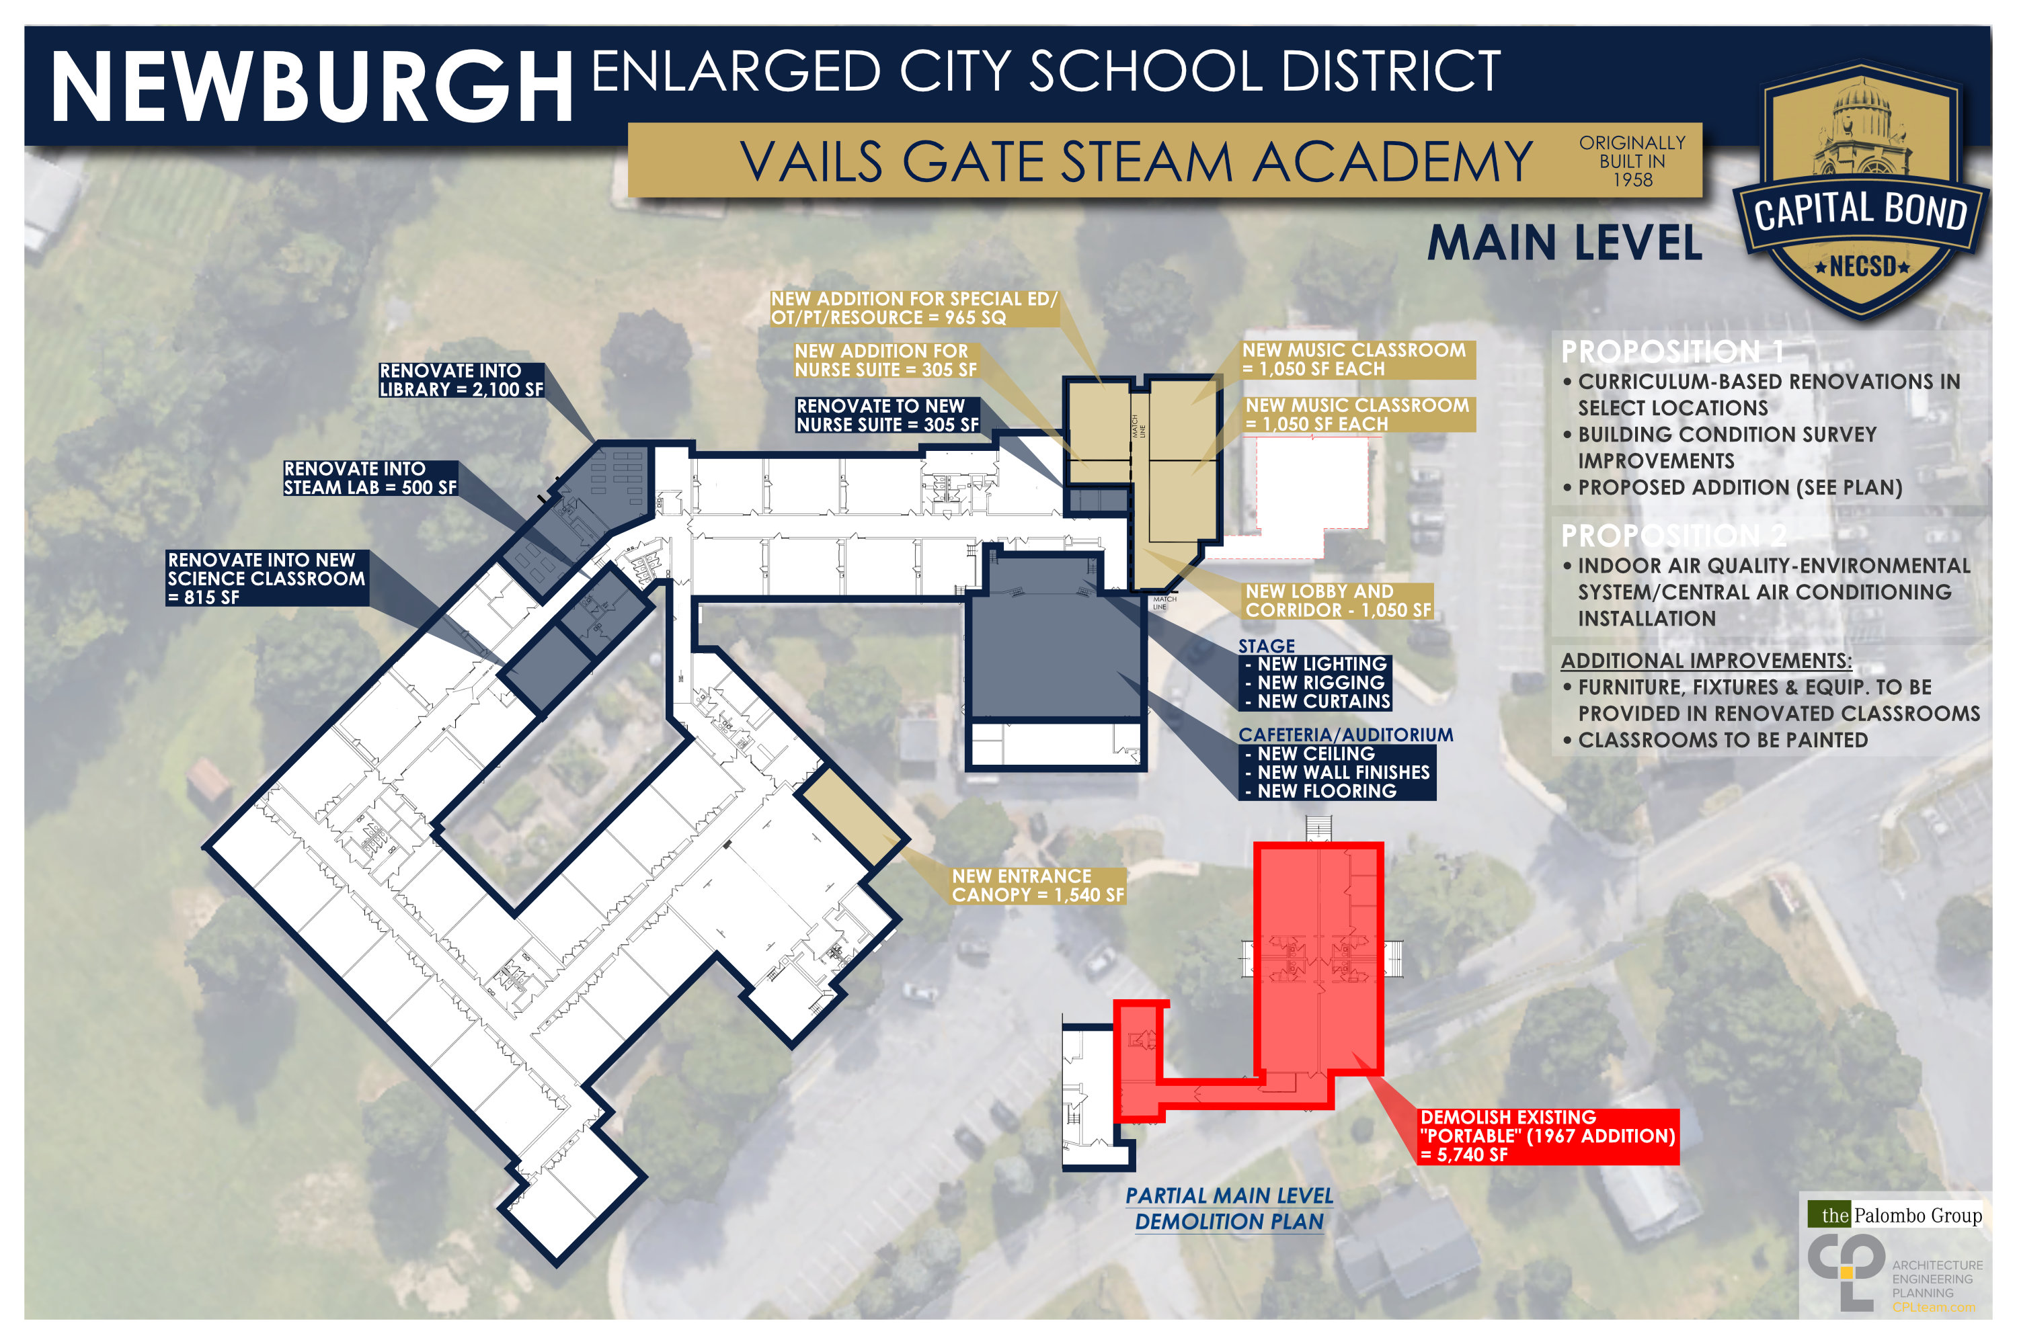
Vails Gate STEAM Academy

Slide 42
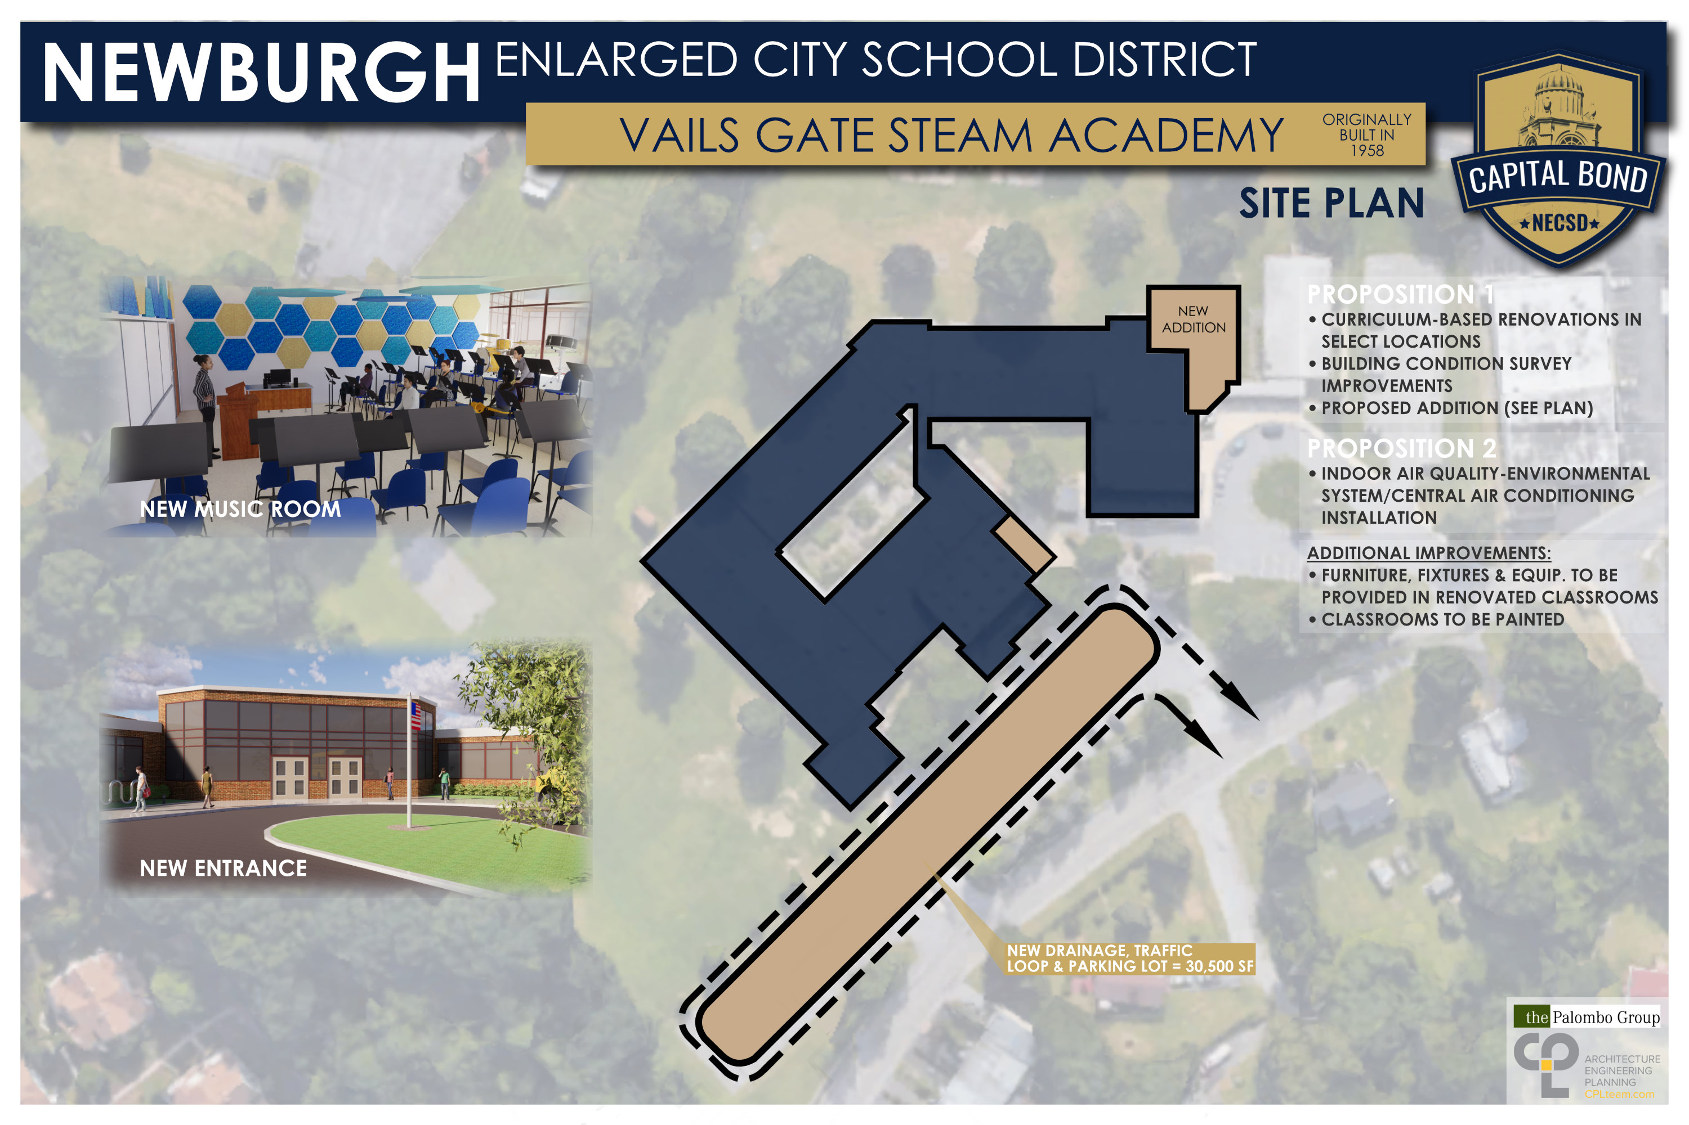
Vails Gate STEAM Academy

Slide 43
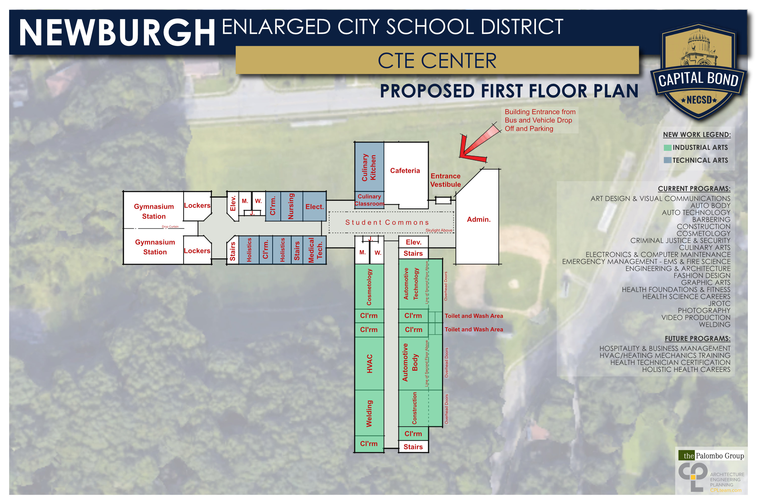
CTE Center

Slide 44
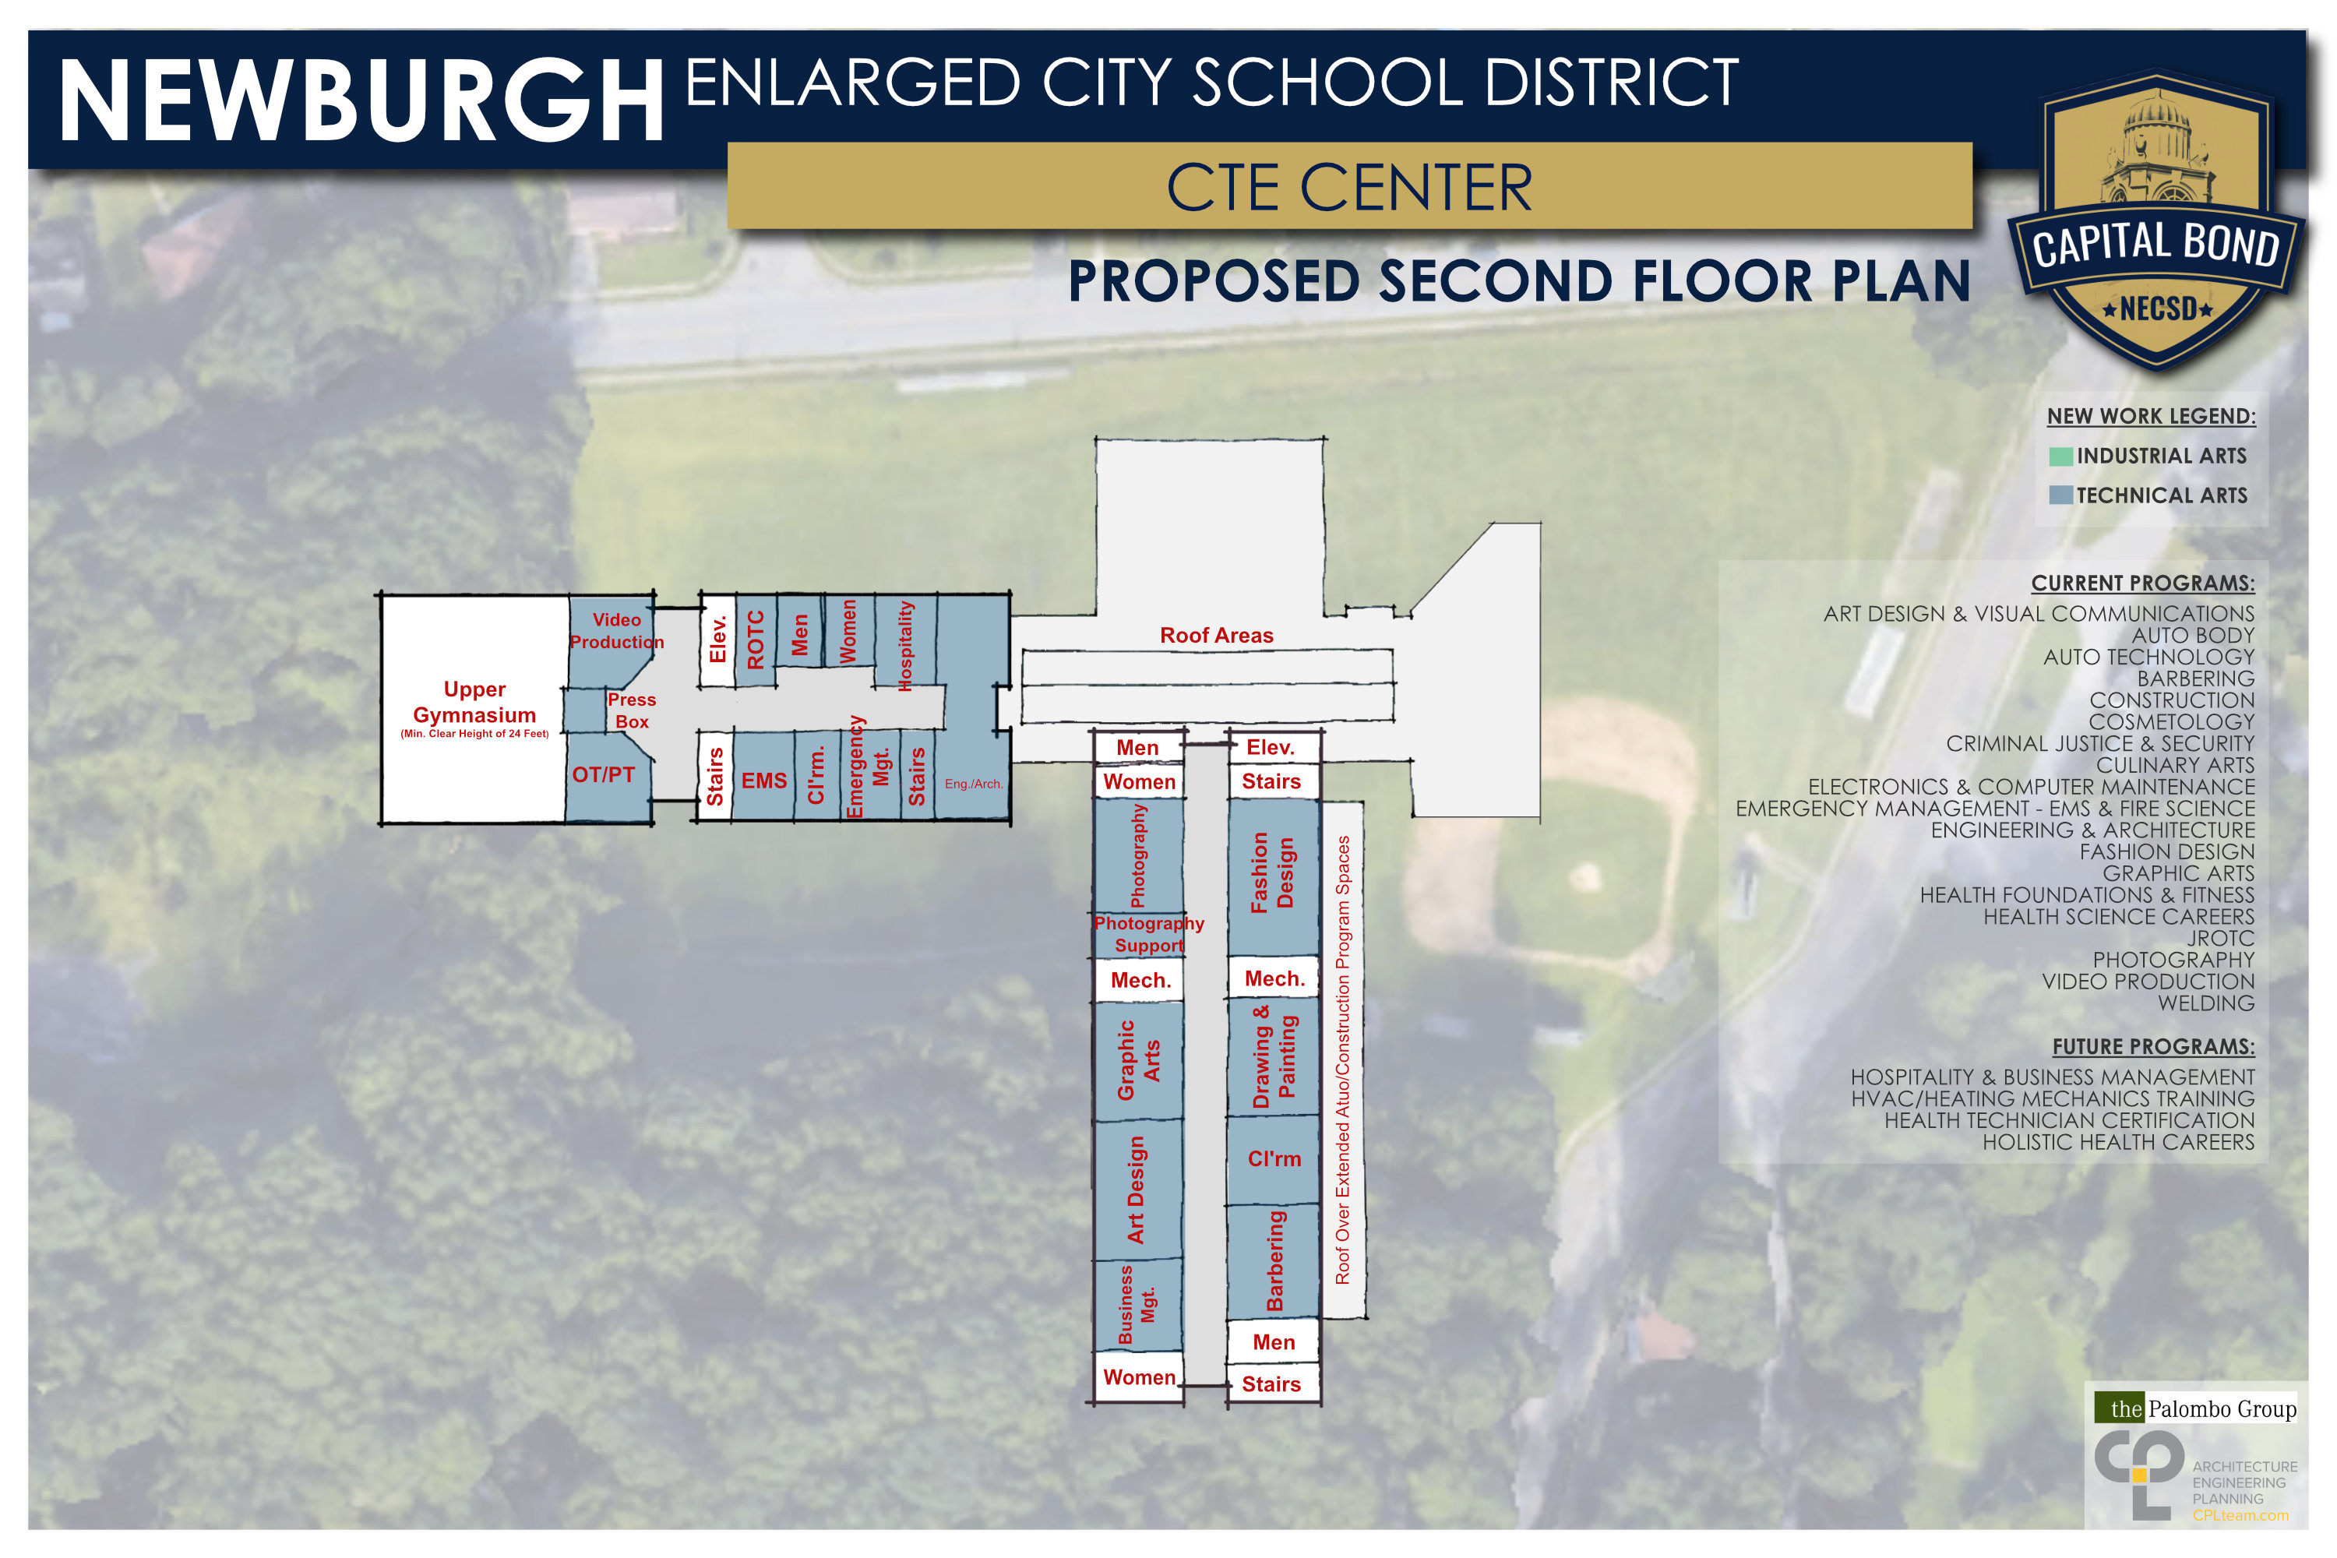
CTE Center

Slide 45
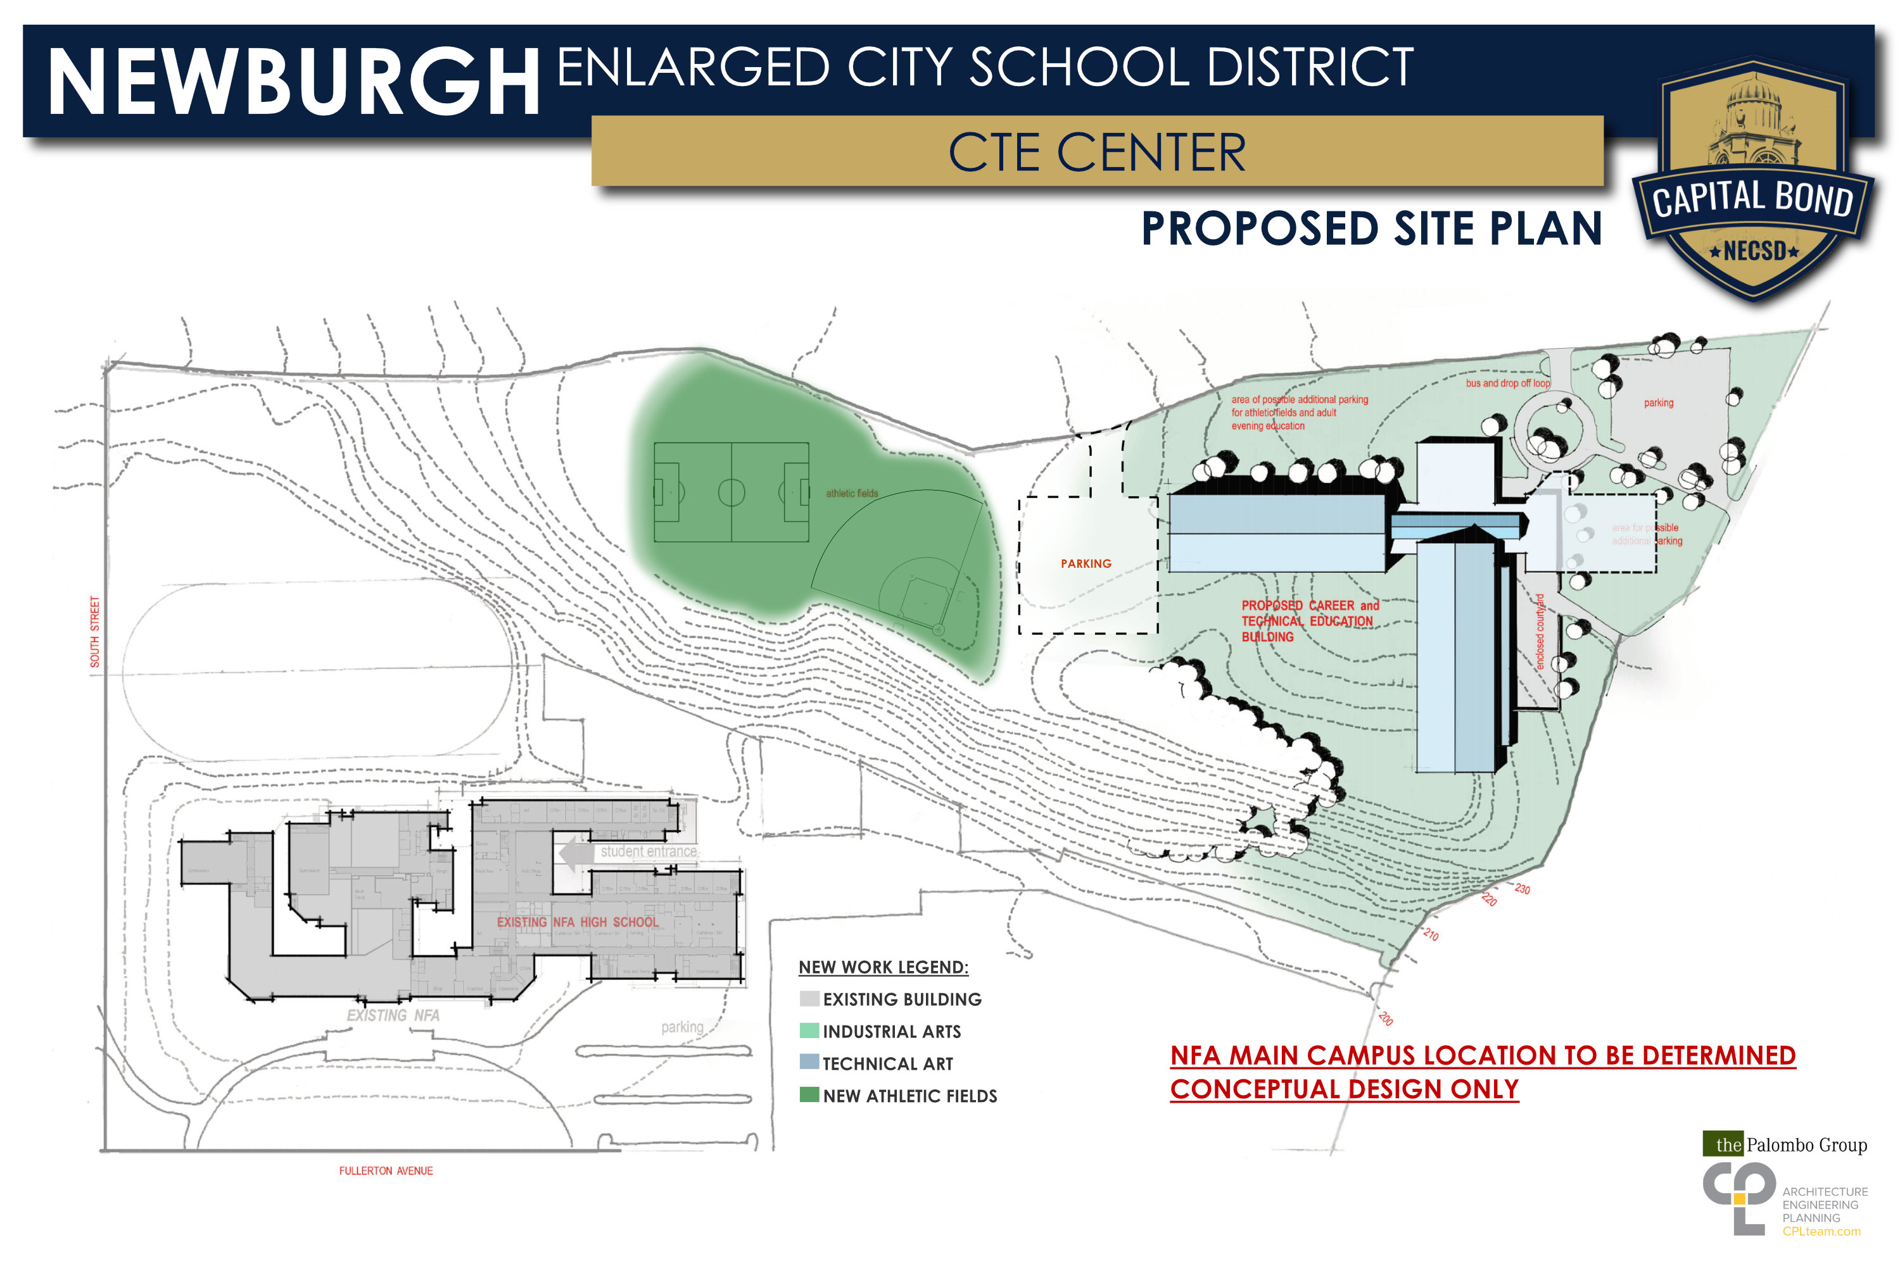
CTE Center

Slide 46
CTE Center

Slide 47
VOTE MAY 21, 2019

